Slide 1
CSR ACTIVITIES
-
GLOBAL COMPACT DRC NETWORK
Regulatory Affairs Department

Slide 2
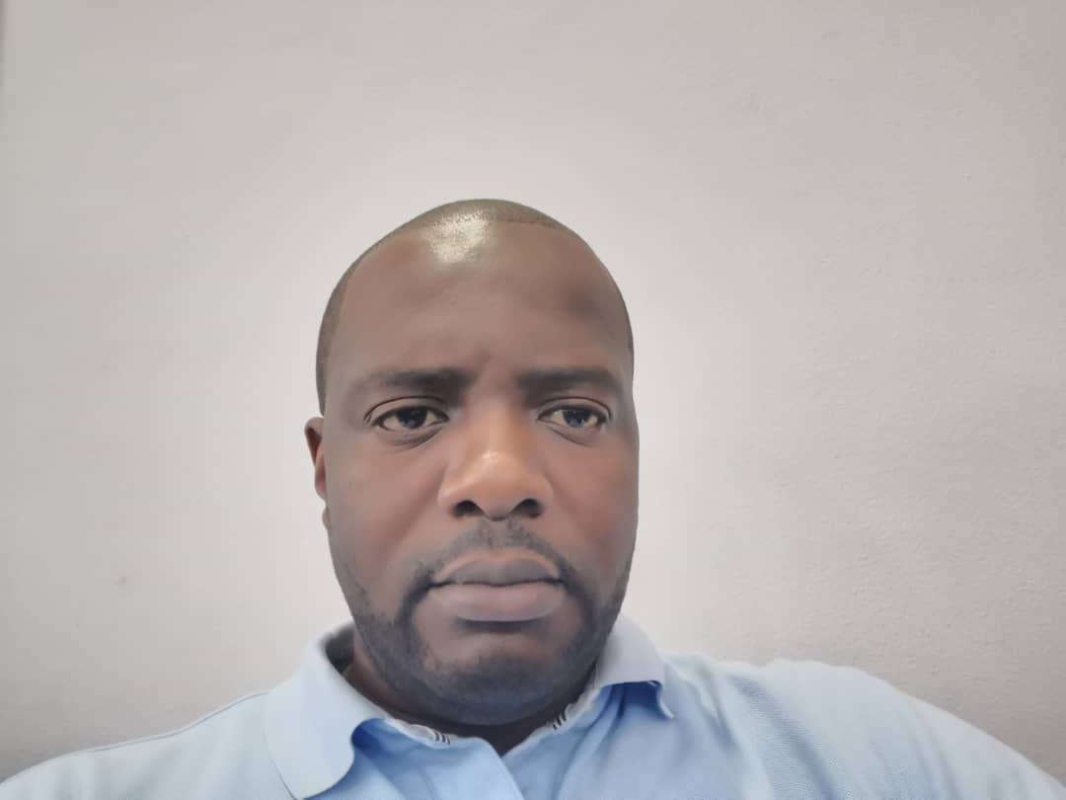
Airtel Africa is a leading provider of telecommunications and mobile money services, with a presence in 14 countries in Africa, primarily in East, Central and West Africa.
Airtel Africa offers an integrated suite of telecommunications solutions to its subscribers, including mobile voice and data services as well as mobile money services both nationally and internationally. The Group aims to continue providing a simple and intuitive customer experience through streamlined customer journeys. https://airtel.africa/
Bharti Airtel established its presence in Africa when it acquired Zain Telecom’s Africa operations in June 2010. The company has achieved significant growth, reaching more than 110 million customers, bridging the digital divide and increasing financial inclusion.
In several of its operations, the company's product offerings include 2G, 3G and 4G wireless services, mobile commerce, fixed line services, home broadband, DTH (Direct To Home) as well as data transfer services nationally and internationally.
Our vision is to connect the people of Africa to one another, empowering them to create opportunities, dream big and transform their lives. Through technology, we will improve the lives of communities by enabling young people to take full advantage of the opportunities of the future.
In order to support our values ​​of SOLIDARITY, DYNAMISM and RESPECT, our mission is to provide world-renowned technology to serve and provide an easy and reliable way to bring people together.
By committing ourselves to the UN GLOBAL COMPACT Network, we support the 17 Sustainable Development Goals defined by the United Nations, through actions that contribute to the social change of populations.
Thierry DIASONAMA
Managing Director

Slide 3
 | PARTNESHIP | EDUCATION | COMMUNITY
SDG | SDG 17 Partnership | SDG 4 Education | SDG 10 Reduce inequality
ACTIONS | 700 racks to be converted into public bins (initiative to support the Mayor of Kinshasa). | Sensitization on the code of conduct for Employee ; ABAC – fight corruption; Leadership | - Contribution towards sustainable livelihoods: participation in a trade fair organized by the Congolese Trade Association (FEC).

Slide 4
 | HEALTH
SDG | SDG 3 Health & well bein
ACTIONS | Action against Ebola in Equator Action against Ebola in the East Region of DRC- Donation of Radioscopic equipment to UNILU As part of the fight against Covid-19 worldwide outbreak, MNOs and government have teamed up in order to curb the negative effects of this pandemic on businesses and on the lives of the Congolese people. Airtel DRC CSR initiatives/support : 1. SMS broadcast: messages on preventive measures are sent to customers, in both French and the local languages; 2. Unique Ring Back Tone (RBT) for all Airtel numbers has been configured to strengthen communication on preventive measures against the pandemic; 3. Toll-free numbers implemented: 101, 109 and 110; 4. 60,000 masks ordered to support the social actions initiated by the government – ordered for terminal students ; 5. AIRTEL partnered with ANICIIS in the fight against Covide-19 through awareness campaigns : Partnership of MoH TV and radio channels with ANICIIS: in order to raise awareness about the pandemic, awareness capsules are also produced and broadcasted on Airtel's media partners 6. MoH-MNO collaboration: Flowminder Foundation, an international NGO, which proposes a solution for the use of data in response to epidemics and natural disasters. It is ready to support MNOs technical teams in the production and use of anonymized CDR data to support decision-making on Covid's response. The project is under management evaluation.

Slide 5
 | PARTNESHIP
SDG | SDG 17 Partnership
ACTIONS | Airtel, member of the UN Global Compact DRC Network, in partnership with the Embassy of the Netherlands participates in activities awareness of the 17 Sustainable Development Goals.

Slide 6
The first Ordinary General Assembly of the Global Compact Network DRC was held on 28 February 2019 at the Congo Call Center with the aim of adopting the 2018 business and financial reports and validating the 2019 action plan.
The assembly had 16 members, including the Vice-President of the Global Compact Network DRC, Mr Celestin Mukeba, the various representatives of the entities Vlisco Congo, Finca DRC SA, Comexas Africa SARL, Bolloré, ITM SARL, First and future, Equity Bank Congo, Airtel DRC SA, JNC consulting SA, M3J international SARL, Bralima SARL, Rawbank SA, THE NGOs REDECOM, AMENSCO as well as the representative of the Embassy of the Netherlands , sponsor of the Global Compact Network DRC.

Slide 7
On March 18, 2019, in collaboration with the Embassy of the Kingdom of the Netherlands, a workshop was held to exchange best practices and awareness around issues of societal responsibility.
Airtel DRC SA, participated in this meeting.

Slide 8
March 7, 2020: Active Women's Day
On the occasion of International Women's Law Day, Synergy DRC in collaboration with the Global Compact DRC Network organized the Active Women's Day, which responds to the "gender" pillar of the SDGs, Sustainable Development Goals, and represents a programme for Corporate Social Responsibility.
Airtel DRC SA, also actively participated.
March and April 2020 Covid-19 Awareness Campaign
The Global Compact DRC Network has joined the efforts of the Ministry of Health and the World Health Organization to raise awareness through the various social networks: Facebook, Twitter and Linked in.
Naturally, Airtel DRC SA offered its media spaces for the dissemination of awareness messages.

