Slide 1
Communication On Progress 2020
www.cofoco.dk

Slide 2
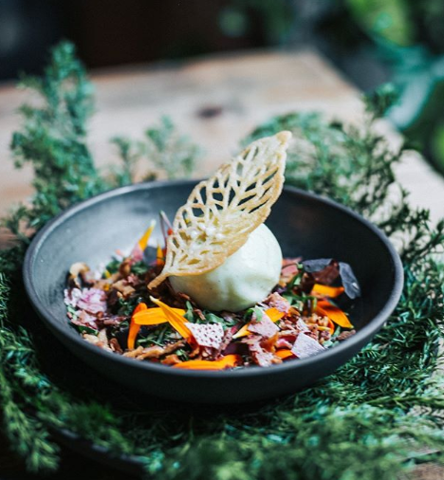
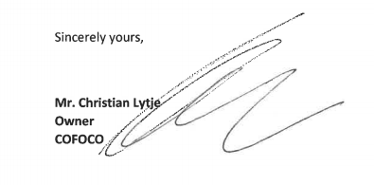
Foreword by Christian Lytje
Owner and Ceo
This is our first Communication on Progress report and it underlines our engagement towards working in a sustainable way in collaboration with our guest and our employees.
It also celebrates our commitment with the UN Global Compact, which we formalized last year.
We have committed ourselves to support the Ten Principles, which have guided and inspired the structure of our overall Corporate Social Responsibility.
In many ways we feel we have worked sustainably since we started opening restaurants in 2004 - using our common sense working with products in season, preferably grown locally and organic, respecting our colleagues and being aware that we treat our employees and our surroundings with respect.
Action speaks louder than words, but sometimes you have to write things down to maximize the effect, and by making this report we take yet another step towards a better future.

Slide 3
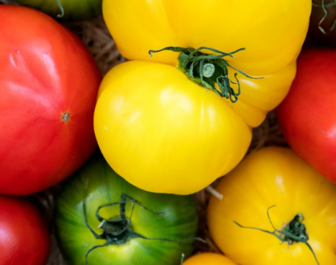
WHO WE ARE
We strive to create surroundings where our guests can feel at home. Surroundings that embraces and allows them to create new desires and traditions. Cofoco was founded on the belief that the good meal should not be expensive. We wanted to create restaurants that made it possible to eat out and get new inspiration.
We have done that since 2004, and the vision will live in the years to come.
Copenhagen Food Collective is a community- a collective where we all gather around for the love of the good meal. We - from floor to kitchen - believe that cooperation creates value. That if we lift together, we can surpass both ours and our guest’s expectations.
It also sets demands. From the raw materials to the experience we create, but also as a whole. We are always looking forward to lifting the level of our industry, making sustainability, animal welfare, human rights and ecology part of our goals. We will continue to renew the restaurant scene and ourselves so that we can continue to present new experiences in Copenhagen.

Slide 4
WHAT HAVE WE DONE?
Carbon free dining & solar cell park (page 5)
We work responsibly with food and food waste (page 6)
We focus on vegan and vegetarian food (page 7)
We love our staff (page 8)
Hotel with Green Key Certification (page 9)
We support local intiatives and unions (page 10)
We are part of REGA (page 11)
Human rights and Anti-Corruption (page 12)

Slide 5
119.500 trees planted since dec 2018
9871 GWH produced since feb. 2018
In 2018, Cofoco entered into a partnership with Green Earth Appeal through the Carbon Free Dining initiative. The initiative is working to establish ecosystems and sustainable forest and agriculture in the Usambara Mountains in Tanzania. The tree planting project aims to educate and strengthen communities with jobs, knowledge and tools to restore biodiversity and establish self-sufficient, sustainable ecosystems benefiting the local environment and the overall CO2 content of the atmosphere. The trees have a measurable effect on the amount of CO2 in the atmosphere, since each tree in an average lifetime (expected 40 years) absorbs in the vicinity of 1 ton of CO2.
We are proud to announce that Cofoco is the first restaurant chain in Denmark to become CO2 neutral with our very own solar park.
In a new type of partnership with solar energy company Better Energy, Cofoco is now co-owners of a solar park, that produces enough energy to cover our needs both now and with future growth of the company. We have invested largely in a solar park the size of 9 football fields that produces 30 % more energy than we rely on in Cofoco, meaning that we achieve a negative CO2 impact on the environment.
By investing in solar energy we minimize the negative impact which running a company that services more than 400.000 guests every year has on the environment. At the same time, we want to show our commitment to helping secure a sustainable future for Denmark.

Slide 6
FOOD & WATER
We put a great effort into recycling our food waste. Especially our chefs and waiters carefully sort out the waste so all of our organic food waste can be recycled. In the kitchen the cooking oil is stored until it gets picked up by Data Refood who recycle the oil and use it to produce biodiesel, which is a green substitute for fossil fuels. Through preventive work and better sorting, we can utilise the scarce resources far better.
https://cofoco.dk/media/images/Food-Waste-Policy-Host.pdf
We focus on organic and locally grown products. And we put things on the menu that is in season.
We only use organic dairy and eggs and we pride ourselves in working with partners that prioritize animal welfare. This is because great taste starts with great products. We are continuously working to secure more sustainable and organic products on our menus and are always mindful in our sourcing.
In all our restaurants we serve our quality Danish water, filtered and bottled to offer the purest taste. We offer sparkling or still to our guests liking. Simple and clean. In Denmark, we have some of the world's best water right in our taps, and we see no reason in buying expensive branded water from abroad, transporting it to our restaurants and selling it at overprice to our guests. Serving filtered water reduces pollution from transportation and the use of plastic bottles. Thus, filtering our perfect Danish water is a sustainable solution we are sticking to.

Slide 7
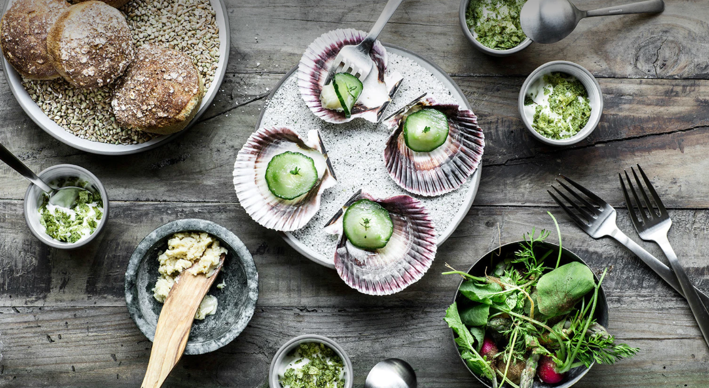
VEGGIES RULE
Eating vegetarian or enjoying meat-free days has become even easier at Cofoco. We have made all our vegetarian menus more visible at our home page.
All of our vegetarian dishes is carefully created from the commodities of the season and prepared thoughtfully. We want to encourage our guests to choose options that are healthier and more sustainable.
As an extra inspiration for our head chefs, we hired a consulent – a former Michelin starred chef – to help us develop and implement more vegetarian dishes.

Slide 8
Café Coco primarily serves organic products, and you will find no plastic bottles in the minibar. All towels and bed linens are made from organic cotton. The entire building has been renovated with energy and water saving solutions and, like Cofoco's restaurants, the hotel is covered by sustainable energy from Cofoco's own solar park in Nees, North West Jutland. For every hotel room booked through our website, we are planting a fruit tree on behalf of our guests.
We commit to:
Saving on nature's resources and strive for our company to minimize the environmental impact.
Continually seek new knowledge and technology that ensures increased environmental protection.
Initiate initiatives and use products that save energy and water
Inform employees how to care for the environment.
Ensure a high degree of recycling and minimization of waste.
Encourage our suppliers to live up to our level environmentally.
Follow Green Key's criteria at all times, follow up on Green Key's inquiries and work actively with the scheme's recommendations.
The Green Key award is the leading standard for excellence in the field of environmental responsibility and sustainable operation within the tourism industry. This prestigious eco-label represents a commitment by businesses that their premises adhere to the strict criteria set by the Foundation for Environmental Education.
A Green Key stands for the promise to its guests that by opting
to stay with the Green Key establishment,
they are helping to make a difference on an environmental level.

Slide 9
Slide med stort billede
This is Gisela – she is 30 years old and from Mexico.
And she is Restaurant Manager in Restaurant Cofoco.
9
We come from 22 different countries
47% women / 53% men in our entire staff
40% of our top leaders are women
HER

Slide 10
We would be nothing without the people who are supporting us. We recognize the incredible value of support and we want to pay it forward by also supporting valuable causes and organizations. We support: DFUNK We support the work of the Danish Refugee Council Youth. This year, we have donated to their work with young refugees in Denmark. The donation goes towards their summer camps across the country. Projekt Q-Værk We have donated furniture and kitchen supplies to Project Q-Værk's new house supporting women and children who have been victims of violence. Hus Forbi For several years we have supplied food for Hus Forbi's annual christmas party for homeless people. The organization supports homeless people in Copenhagen by selling their namesake newspaper on the street and through subscriptions. Cofoco also supports local athletics organizations, companies and educational organizations through donations and gift certificates. Vesterbro Julehjælp http://www.kfuksa.dk/ HODJA Nørrebro Børnefilmklub

Slide 11
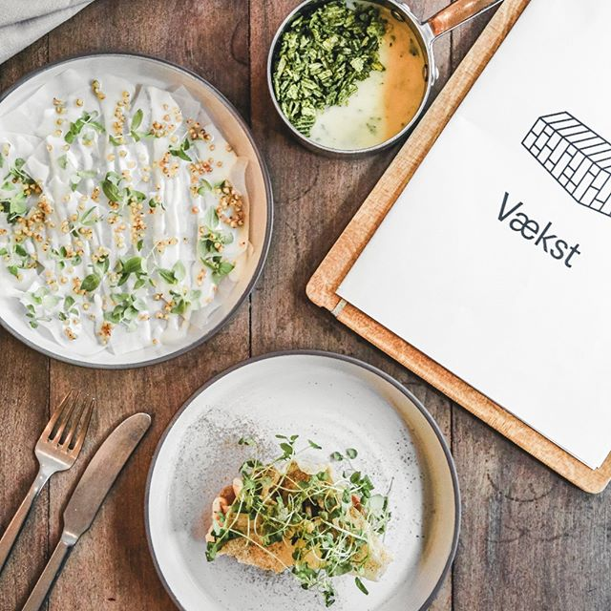
Cofoco is putting social responsibility on the menu with new industry initiative
We are proud to announce that Cofoco alongside 13 other restauranteurs in Denmark and DRC (Denmark's Restaurant and Cafe Organization) have created REGA - an organization promoting human rights, environmental sustainability and anti-corruption within the restaurant industry.
We are very happy to see the birth of REGA and hope many more of our industry colleagues will join the initiative to bring the industry up to a level of sustainability that we can all be proud of. We also hope the work done through REGA will inspire other industries to put human rights, environmental sustainability and anti-corruption on their agendas.
REGA works towards developing a new policy for responsible corporate management within the industry by 2020. This means that REGA is still a work in progress and will continue to develop as we go. It also means that we have a great opportunity to shape the initiative and the industry through our own sustainable initiatives. REGA offers a platform to share knowledge on responsibility and sustainability and we look forward to sharing what we know and do at Cofoco.
About REGA:
REGA is an industry initiative focusing on social responsibility. It is a partnership between Danish restauranteurs who want to elevate the standard of social responsibility within the restaurant (and cafe) industry. Through REGA, we as members commit to running responsible businesses with high standards of social, environmental and economic sustainability.
REGA delivers a Best Practice check list, that clarifies both how the restaurant industry can run responsible and sustainable businesses and how we as an industry can work together to secure a better and more sustainable future.
REGA is the world's first industry initiative focussing on social responsibility and is also a stamp of quality for its members, proving the highest level of commitment to social responsibility for the restaurant industry in the world.

Slide 12
Human rights and Anti-corruption
In our work with social responsibility, we strive to ensure financial sustainability by focusing on anti-corruption and human rights. This means that we have established a management system where we can demonstrate that we seek to prevent all forms of corruption and that we are dealing with risks of adverse effects on human dignity in relation to our business.
Specifically, this means that we have developed guidelines, and that we continuously assess whether the guidelines work. The system for establishing a management system is well defined by the OECD Guidelines on Multinational Companies.
Our goal is to become transparent by implementing, defining and develop guidelines to our leaders, staff and suppliers by dealing with the 2004 UN Convention on Anti-Corruption and the UN Guidelines on Human Rights and Business.
Examples of what we need to deal with in efforts to prevent all corruption are the handling of political contributions, sponsorships, etc., guidelines for gifts and prevention of nepotism. And we must deal with the possible effects on all human rights (there are 48). Some rights will not have the risk of having an impact, but most will identify risks of negative impacts of around 20 rights.

Slide 13
Thank you!
www.cofoco.dk
https://www.instagram.com/cofocodk/
+45 70 70 15 88
info@cofoco.dk

