Slide 1

The Educational inclusion of migrants: the case of Syrian and Migrants in Lebanon and LIU in specific.

Slide 2

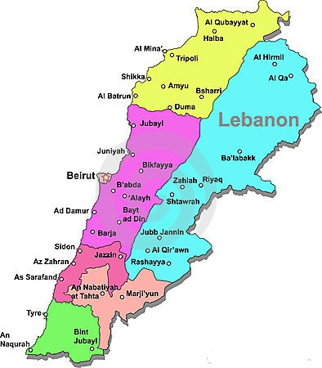

Slide 3

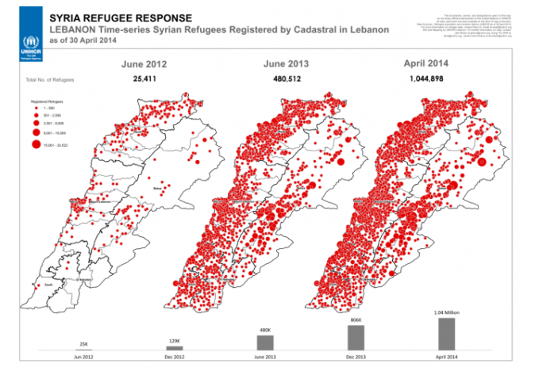

Slide 6
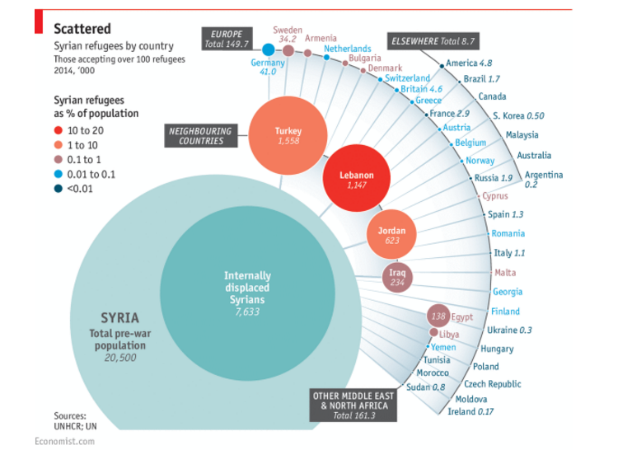

Slide 7
Vulnerability Assessment of Syrian Refugees in Lebanon 2016
US$ 2.48 billion requested to ensure the well-being of refugees.
By August 31, 2016, US$ 980 million had been injected into the Lebanon Crisis Response Plan 2016 (LCRP) designed by the Government of Lebanon and partners, slowing a further slide into poverty for most refugees.
US$224 Million more to support the Lebanese education system through a program Reaching All Children with Education 2 program
Total of US$ 1.24 billion out of the US$ 2.48 billion were paid.
Where do you generate US$ 1.24 billion
http://reliefweb.int/report/lebanon/vulnerability-assessment-syrian-refugees-lebanon-2016

Slide 8
Beyond the
Skills Gap:
Making Education Work
for Students, Employers,
and Communities

Slide 9
The series of gaps between our education policies and the needs of Syrian students seeking career education are far more threatening to our economic future than the
much-discussed “skills gap”

Slide 10
THE GAPS IN HIGHER EDUCATION POLICY to serve displaced Syrian students:

Slide 11
Employability
Teaching & Learning
Models, Design & Strategies of curriculum
Environment & Culture
Governance & Approaches

Slide 12
Three of the core design elements of the financial aid:
1.Programs have a large impact on how
institutions recruit Syrian students,
2.Design programs and credentials,
3.Deliver instruction.

Slide 13
These core design elements are the source of five “policy gaps” between the meeting the needs of Syrian students in career education programs and the behavior of institutions of higher
education.

Slide 14
Policy Gap #1: Accrediting institutions rather than programs
Policy Gap #2: Looking inward rather than outward for
indicators of quality
Policy Gap #3: Ensuring the quality of degrees, but not
certificates
Policy Gap #4: Paying for time, not learning
Policy Gap #5: Rewarding enrollment, not outcomes

Slide 15
Fixing the gaps means moving beyond entrenched policies that protect institutions, but not students, from the consequences of programs yet to meet 21st century skills.

Slide 16

Project SEAD
S - Social
E - Emotional
A - Academic
D - Development

Slide 17
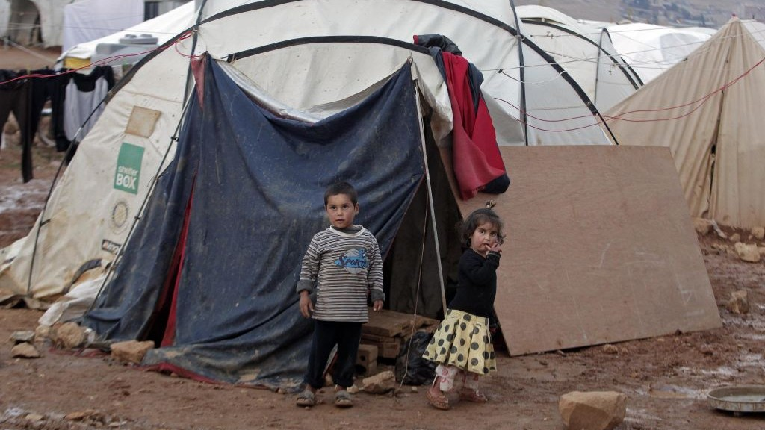
Where Did It All Start?
Financing the education of thousands of Syrian refugee children who are deprived of schooling and reside in tents (500,000)
Age 6-12= 250,000
Age 13-18= 250,000
One of the world’s most challenging education crises in accessing to any formal or informal schooling.
Notes:
250,000 of Syrian refugee children lack access to any formal
or informal schooling.

Slide 18

Project success
Vision
+
Skills
+
Incentives
+
Resources
+
Action Plan
=
Change
+
Skills
+
Incentives
+
Resources
+
Action Plan
=
Confusion
Vision
+
+
Incentives
+
Resources
+
Action Plan
=
Anxiety
Vision
+
Skills
+
+
Resources
+
Action Plan
=
Resistance
Vision
+
Skills
+
Incentives
+
+
Action Plan
=
Frustration
Vision
+
Skills
+
Incentives
+
Resources
+
=
Treadmill
Adapted from Knoster, T. (1991) Presentation at TASH Conference, Washington DC (Adapted by Knoster from Enterprise Group Ltd.)

Slide 19


Slide 20
LIU Mission Statement
.
Provide accessible and affordable higher education in excellence and quality of first order.

Slide 21

Overviewing TD Program for Syrian Refugees Student-Teachers

Slide 22

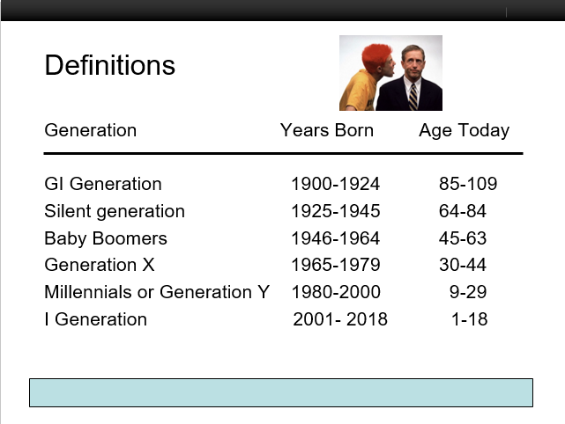
Generation

Slide 23

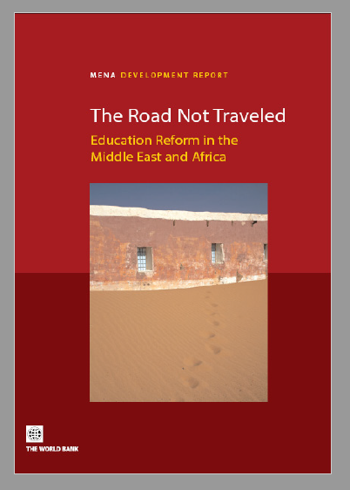


Slide 24

Curriculum
Goals/objectives
Program
Strategies/methods (pedagogy)
Assessment

Slide 25


Syrian University Graduates benefiting from LIU’s Scholarships: invited to join TD program
If children cannot go to schools,
let the school come to them
Syrian kids in tents are taught by Syrian TD holders equipped to teach them

Slide 26



Slide 27

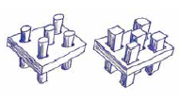
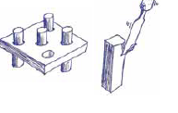
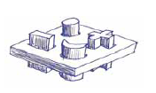
Approaches to Education of Students with Migrants and SEN (INEE, n.d.)
# | Approach | Main Theme | Diagram
1 | Segregation | An education system for ‘normal’ children (round pegs); and a different system for ‘special needs’ children (square pegs).
2 | Integration | Trying to change children so they fit into the ‘regular’ system (making square pegs fit into round holes). The system stays the same. The child must adapt or fail.
3 | Inclusion | All children are different and all can learn – we change the system to accommodate everyone and achieve education for all.

Slide 28


www.leadar-lb.com
Lead
Consultant
UK-Based with extensive experience in MENA-War Zones
International Consultants
Local
Consultants
UK- US- Canada- New Zealand- Norway- Netherlands- Austria
Expert school teachers/coordinators in Lebanon

Slide 29
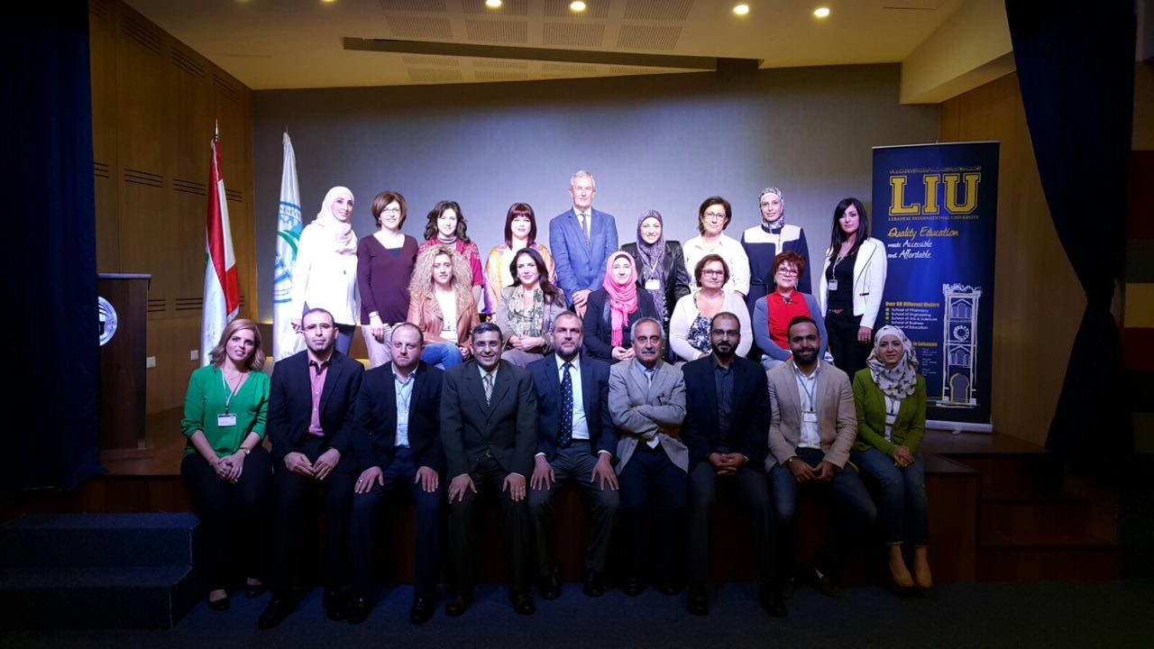

Slide 30
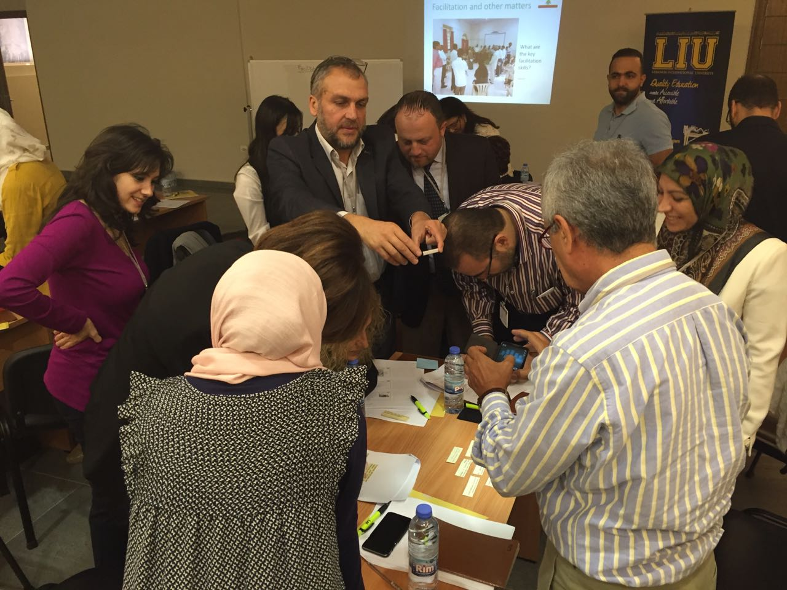


Collaborating Parties

Slide 31
The Programme
24 Credits
FALL
SPRING
Teaching of Math & Science at the Elementary School using Cheap and Inexpensive Material (3 Cr.)
Integrated Curriculum (3 Cr.)
Educational Psychology for Students with Post-war Stress Disorder (3 Cr.)
Practicum at the Elementary School (3 Cr.)
Teaching of Lang. Arts at the Elementary School using Cheap and Inexpensive Material(3 Cr.)
Assessment and Evaluation at the Elementary School (3 Cr.)
Differentiated Instruction (3 Cr.)
Practicum at the Elementary School (3 Cr.)

Slide 33
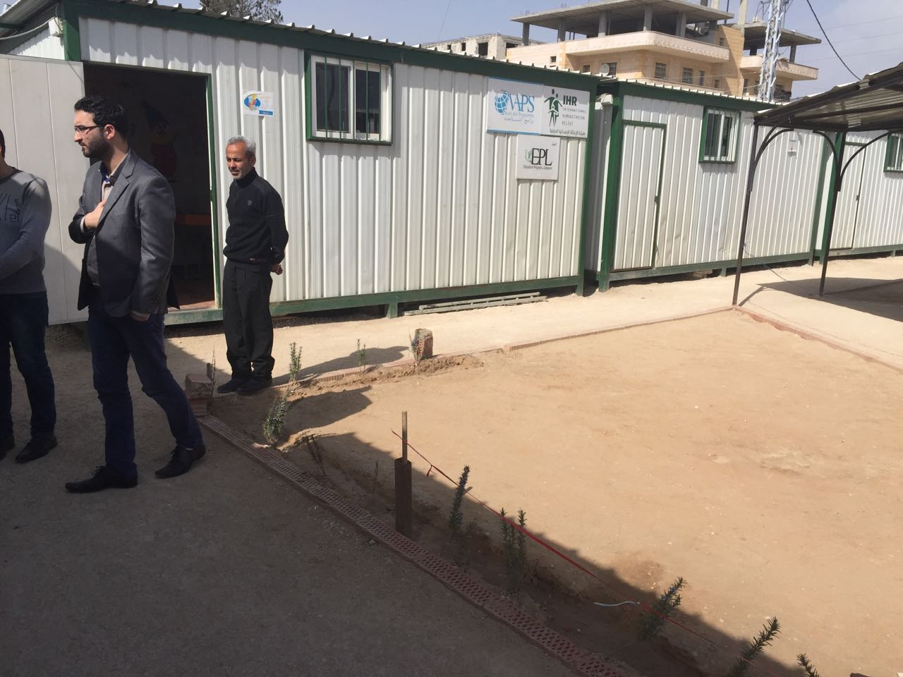

Slide 34
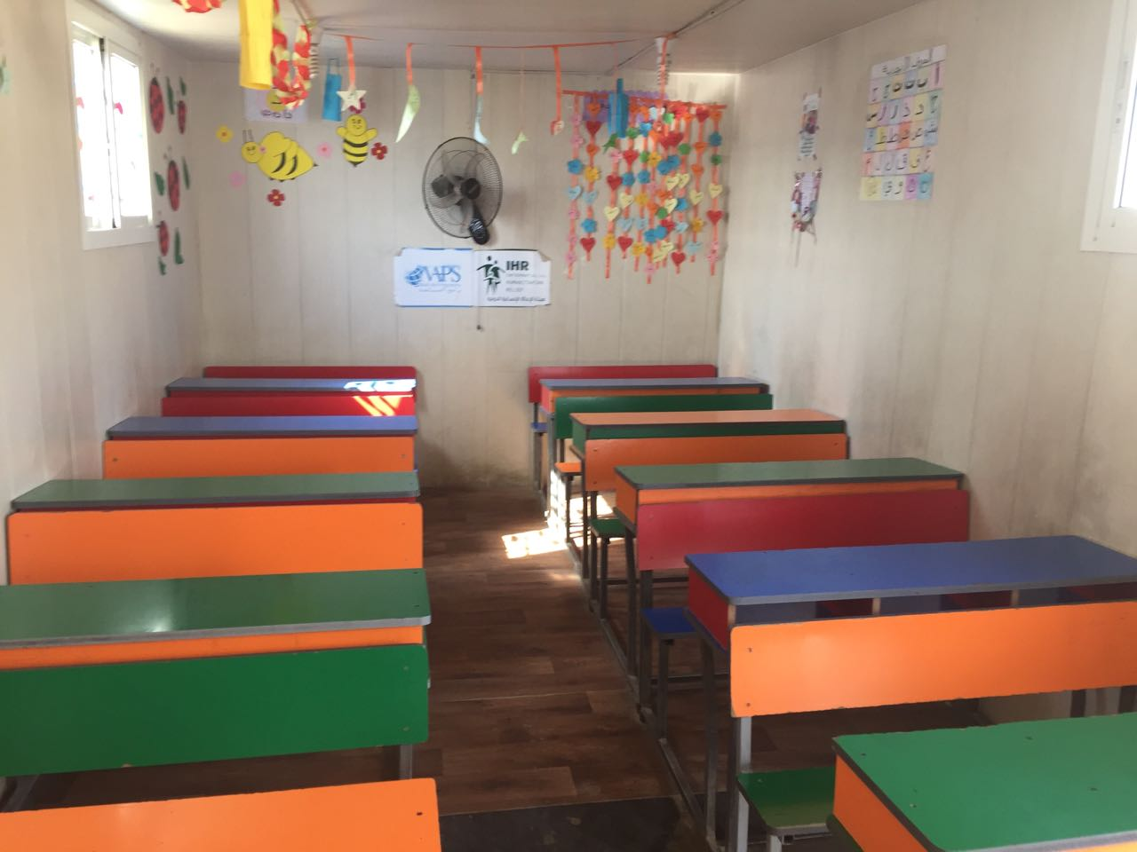


Anticipated Challenges

Slide 35
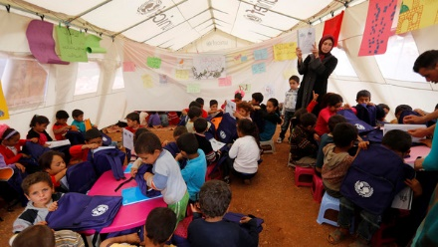
Home-Room Teacher
Home-Tent Teacher

Slide 36
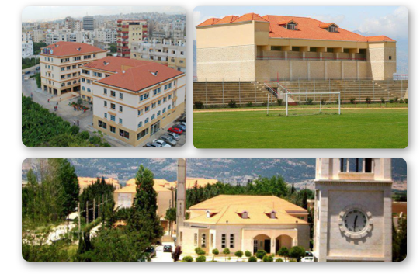
Research Study that will Run Parallel to the Programme

Slide 37
Achievements
What have we accomplished in training teachers?
Academic year 2013-2014:
Total # of beneficiaries: 1200 Syrian students
Academic year 2014-2015 :
Total # of beneficiaries: 2000 Syrian students
Academic year 2015-2016:
Total # of beneficiaries: 3000 Syrian students
Academic year 2016-2017
Sponsored a conference in Slovenia in January 2017 after compiling Interdisciplinary of researches and building bridges to build awareness of this crisis in Lebanon.
LIU to add new TD implemented as to have graduates teach 5000 beneficiaries.

Slide 38


Slide 39
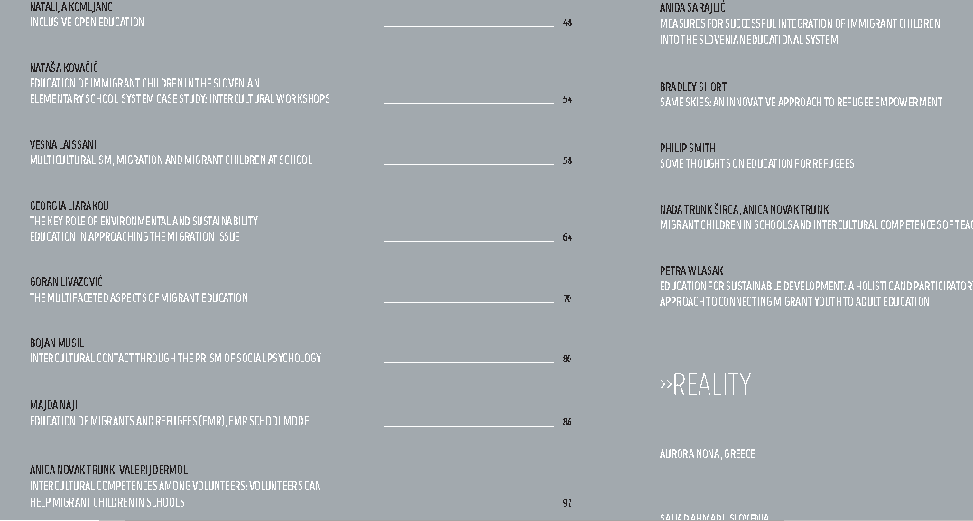

Slide 40
Reflection by Syrian Student
https://www.dropbox.com/s/qic9qnglg9jqwld/TD%20-%20LIU.mp4?dl=0

Slide 41




www.liu.edu.lb
 | anwar.kawtharani@liu.edu.lb
 | @kawtharaniAnwar
 | anwarkawtharani
 | 0096170976967

