Slide 1
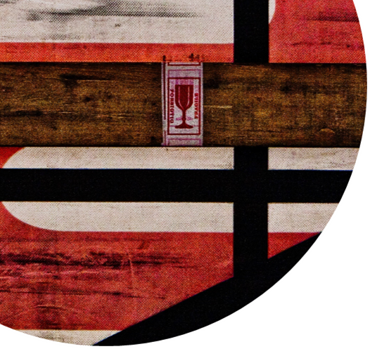













This is our Communication on Progress 2019 in implementing the principles of the United Nations Global Compact and supporting broader UN Goals.
We welcome feedback on its contents

Slide 2
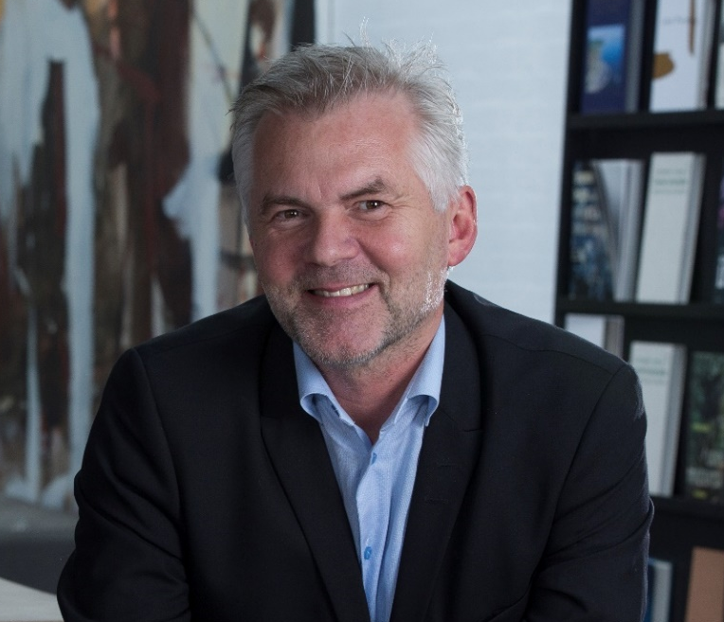
Statement from the EVP Jørgen Jessen
In our fourth year as a participant in UN Global Compact, it is with great satisfaction I can witness that our organization has fully embraced the principles and actively support sustainability.
We have worked diligently to improve and this year’s update confirms our significant progress. We have revised our purpose and mission statements – which now better reflect our organization and emphasize the human aspect of our company.
We have also clearly defined environmental objectives and expanded our policies on environment, quality, health and safety, code of conduct and anti-corruption.
The progress report will be distributed to all staff and shared with our customers and other business partners.
On behalf of all our Scan Global Logistics employees, I would like to thank you for the interest in our report and company.
Jørgen Jessen
Executive Vice President,
Member of the Executive Management Team

Slide 3
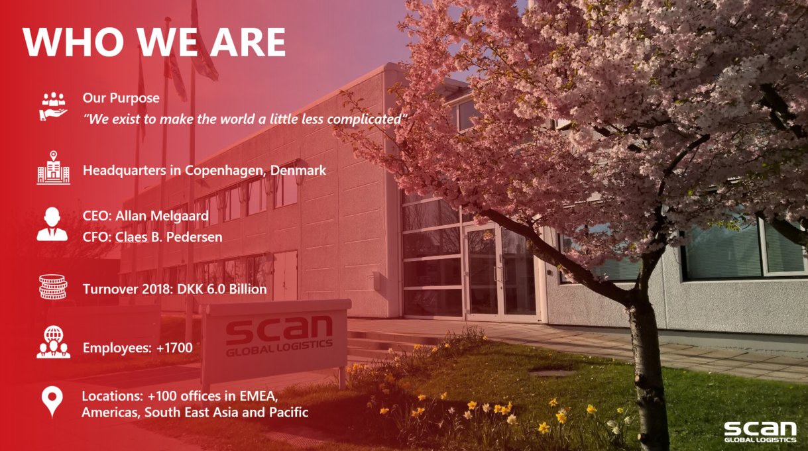
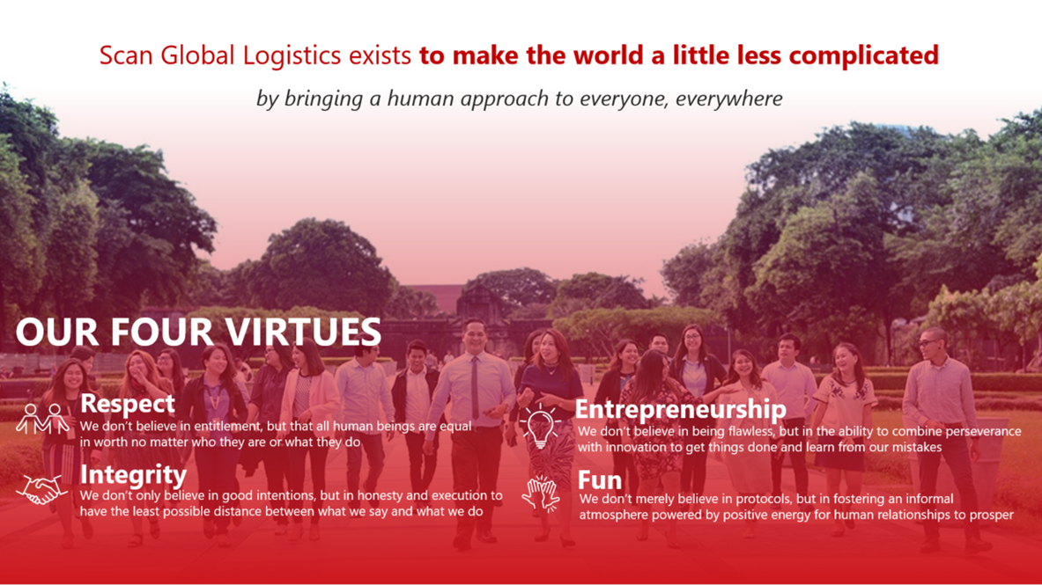
About us
Our culture, purpose and virtues

Slide 4
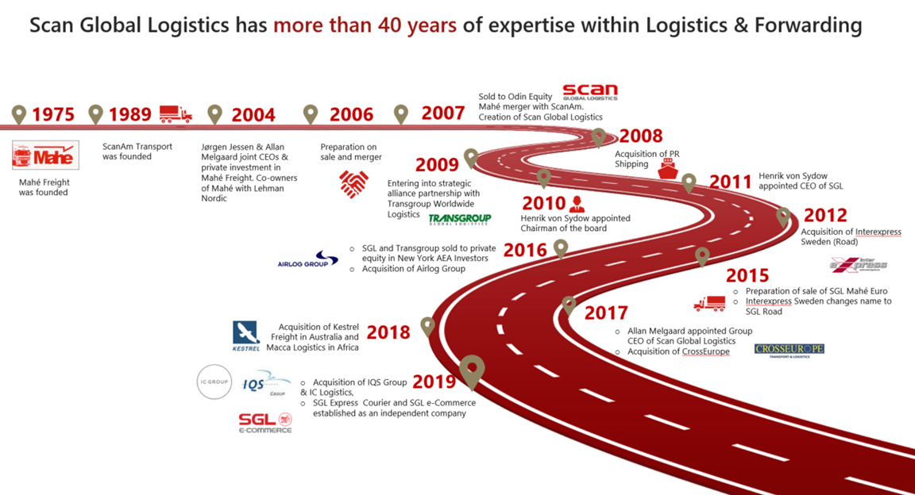
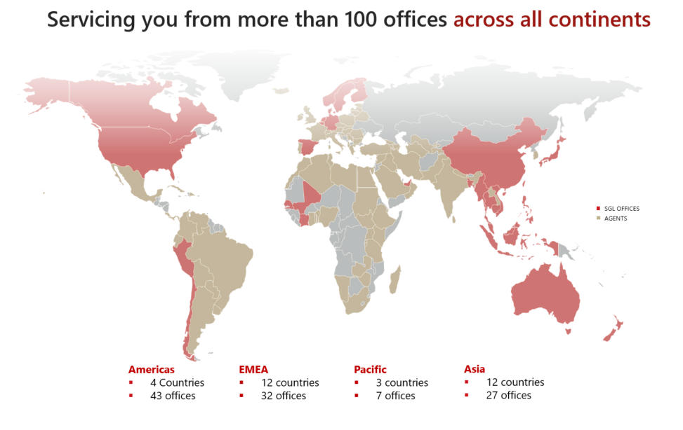
Our history
Our global footprint

Slide 5

Key programs and initiatives
Mandatory Code of Conduct training for employees
  90% of staff passed the test in 2018
Obtain ISO 14001 certification in Finland and Norway
  Finland completed in 2018, Norway scheduled January 2019
Environmental demands imposed on sub-contractors
  Stringent qualification process
  More than 90% of our hauliers have engines with Euro norm 5 or 6 in their trucks
Programs in place aimed at reducing electrical consumption as well as paper consumption
  Reduce electrical consumption by 5% per employee in 3 years
  Reduce paper consumption by 5% per employee every year
Commitment to reduce the amount of combustible waste
  Reduce combustible waste to become max. 20% of total
Various activities supporting local communities
  Participation in local fundraisers

Slide 6
Achievements
Targets | Achievements
Obtain ISO 14001 certification in Finland and Norway | ISO 14001 certification achieved in Finland and Norway
Use sub-contractors that operate trucks with engines that meet the Euro norm 5 or 6 | More than 90% of trucks used meet the norm
Reduce electrical consumption by 5% per employee in 3 years | 8,0%
Reduce paper consumption by 5% per employee every year | 4,3% reduction per employee
Reduce combustible waste to become max. 20% of total | Measurement available in Q1 2020
Obtain OHSAS 18001 / ISO 45001 in Sweden | Achieved OHSAS 18001 / ISO 45001 in Sweden
Establish multiple site certification in Denmark and Sweden | Achieved multiple site certification for ISO 9001 (Quality) and ISO 14001 (Environment) for Denmark, Norway, Sweden and Finland
Implement mandatory Code of Conduct training for employees | 78% of all employees passed the training year to date 2019 (passing score >80%)
Other | ISO 45001 implemented (Work Environment, Occupational Health and Safety) for Industrial Projects in Denmark
Other | Registered in Sedex Advance with goal of increasing our involvement with SEDEX in 2020

Slide 7


Corporate Social Responsibility
Scan Global Logistics is committed to sustainability and social responsibility, reduction of environmental impact, the well-being of our employees, and ethical behavior. We operate as an asset-light freight forwarder and base our business model on providing value to customers by providing advanced supply chain solutions. We rely on sub-contractors to provide the physical transport and have limited impact on primary transport methods such as aircrafts and vessels. Thus, our focus is to engage actively with customers and suppliers in decreasing the environmental footprint by taking actions within our sphere of influence.
We integrate the focus areas in our daily business; we apply them in how we manage risks and opportunities; and how we meet the ever-changing environment in which we operate.
Our strategic focus is built around following framework:
Reduction of environmental impact
People
Ethical behavior
AEO & ISO Certified
Co2 emission reports
Co2 efficiency products
We believe in who cares wins
Responsibility to reduce our collective impact on
the limited resources of our planet
IT IS NOT JUST ABOUT WHAT WE DO
— IT’S HOW WE DO IT!

Slide 8




Human Rights
The Scan Global Logistics’ Code of Conduct was established in 2013 and applies to all regions of Scan Global Logistics. The Code of Conduct lays down guidelines for day-to-day workplace conduct for our workforce of some 800 employees. The Code of Conduct also sets out our commitment to the health and well-being of our employees, as well as our understanding of equal opportunity and diversity. The Code of Conduct is underpinned by additional Group policies such as the Anti-Corruption Policy, which provides clear instructions on how to handle gifts, benefits and offers of hospitality. The Competition Compliance Policy prohibits agreements with competitors.
The Code of Conduct is an integral part of our corporate culture and is closely aligned with our values; “Dedicated, Reliable, Committed”. Our Code of Conduct is guided by the principles of the Universal Declaration of Human Rights, the UN Global Compact as well as the conventions issued by the International Labour Organization (ILO).
The Code of Conduct is guided by the principles of the Universal Declaration of Human Rights, the UN Global Compact and those of the 1998 International Labour Organization (ILO) declaration on the fundamental rights and principles of work as well as the OECD Guidelines for Multinational Enterprises.
To deny people their human rights is to challenge their very humanity.
- Nelson Mandela, 1990
Labour
Scan Global Logistics respects human rights and we conduct our business in a manner that makes us an attractive employer.
We are clearly committed to the elimination of all forms of forced or compulsory labor
We do not engage in human trafficking
Our employees are free to join or not to join a union/employee representation of their choice, free from threat or intimidation.
We do not discriminate and provide equal opportunity for all
We comply with European Union regulations as well as national or local safety regulations (national law and the binding regulations of our mandatory accident insurance)

Slide 9



Environment
SGL is a Scandinavian-based logistics group with employees and partners worldwide. We have our own offices in 19 countries, and our business keeps growing. We will continue our global expansion to ensure that we are an attractive partner to our customers. We serve our clients with global transportation and logistics solutions in sea, air and road and special services (aid & development and projects). Environmental conditions are an integrated part of SGL's management. We consider environmental issues and make it visible to our customers, suppliers and especially to our employees. Therefore, SGL has established an environmental management system in accordance with the DS/EN ISO14001 requirements. The environmental management system ensures that the environmental impact from activities and services is constantly reduced. For this reason, the following environmental objectives form the basis of SGL's ongoing environmental activities.
Environmental objectives
We will actively reduce emission to the extent it is possible.
We will foster environmental responsibility by increasing employee awareness of the environmental control system and objectives, and ensure commitment to environmental work through education and training.
We will make environmental demands on suppliers through dialogue and cooperation.
We will ensure that our efforts will result in continuous and measurable environmental improvements.
We will proactively inform our clients on environmental issues.
We conduct environmental assessments of major investments and changes.
We have an open dialogue with authorities, customers and other stakeholders, and provide information regarding the company's environmental conditions.
We comply with applicable laws and regulatory environment.
We will select the best available techniques considering both environment and economy.
We will encourage our employees to make continuous improvement proposals that may affect the environmental areas in a positive direction.
We will continuously work to reduce consumption of electricity, water and heat in the organization.
We will continuously reduce resource consumption for transport of goods by making the most of available capacity.
We will continuously improve sorting, storage, recycling and disposal of all waste products which are the result of company activities and services.
We pledge to continuously guard against and prevent negative environmental impact.
We will prioritize road transport with Euro norm 5 + 6 vehicles.
We have purchased CO2 quotas and thus the SGL website is CO2 neutral

Slide 10


Anti-Corruption
It is our policy to conduct all of our business in an honest and ethical manner. We take a zero-tolerance approach to bribery and corruption and are committed to act professionally, fairly and with integrity in all our business dealings and relationships, wherever we operate.
We act with integrity and are accountable to stakeholders for our actions and relationships.
We do not promise or provide bribes or any other inducement or reward in order to gain any commercial, contractual, regulatory or personal advantage.
We do not accept gifts or hospitality from a sub-contractor or third party where there is an expectation that a business advantage will be provided by us in return
We do not make, and will not accept, facilitation payments or "kickbacks" of any kind.
We have an established sub-contractor management policy and undertake due diligence of our business partners. Sub-contractors are continuously screened in accordance with our policy and UN Global Compact’s ten principles.

Slide 11
Ending note
The commitment to UN Global Compact’s Ten Principles remains anchored in Scan Global Logistics’ strategy and behavior. We are continuously working on initiatives and activities aimed at protecting the rights of all, both within our communities and with our employees. We will strive to further improve and we are committed to an ongoing communication on the subject towards shareholders, clients and employees.
For questions, please contact:
Jørgen Jessen, Executive Vice President, +45 4010 5882 or jj@scangl.com
Ragnar Dalen, UN Global Account Manager, +45 2322 2302 or rdal@scangl.com
Maj-Britt Mosbek, Communication Specialist, +45 3248 0111 or mmf@scangl.com
---oo0oo---

