Slide 1
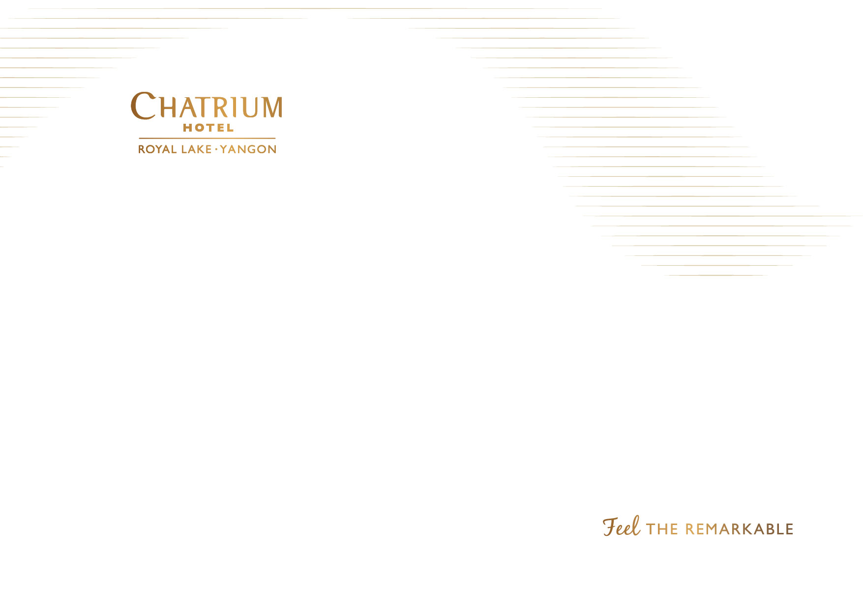
Chatrium Hotel Royal Lake Yangon
Year 2019 CSR Report

Slide 2
SOCIAL CONTRIBUTIONS
(DONATION ACTIVITIES)

Slide 3
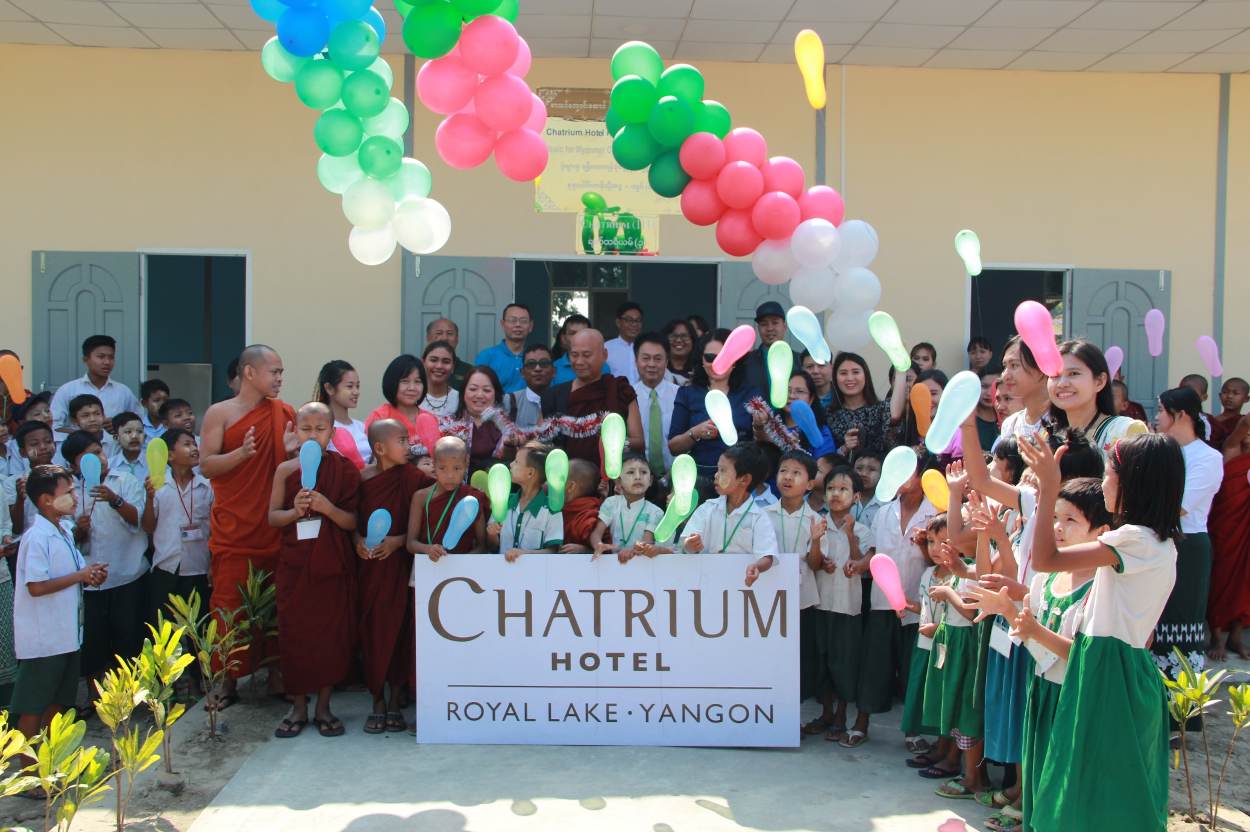
School-Building Donation for Orphans and Vulnerable Children
To improve the social well-being and education of vulnerable and disadvantaged children throughout Myanmar, we donated a building (50’x20’) for reading, teaching and multipurpose to Nawarat Monastic school, at Shwe Pyi Thar Township which can accommodate 400 students and worth about (USD 11,200).

Slide 4
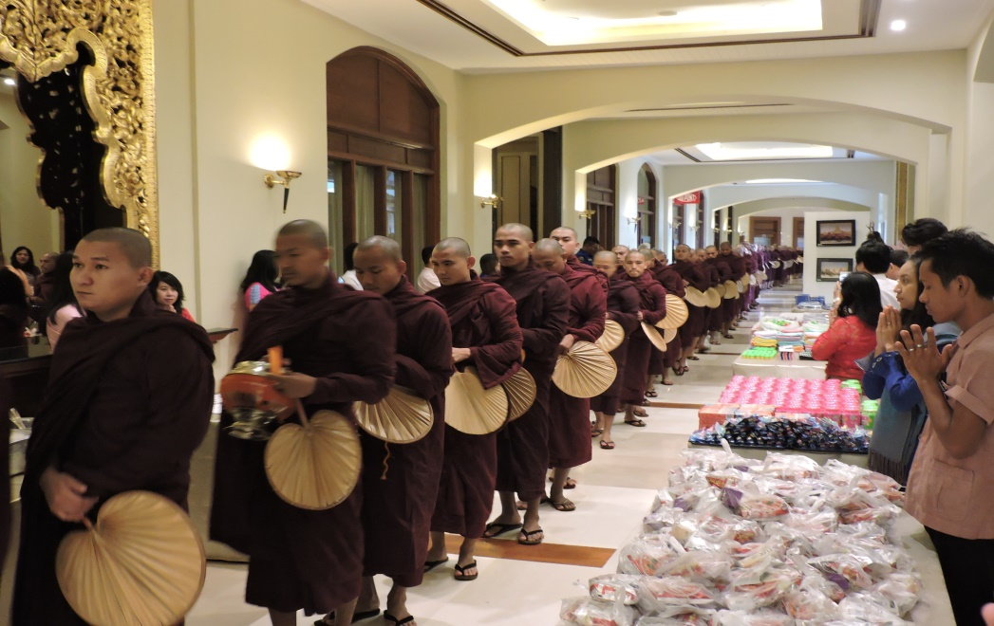
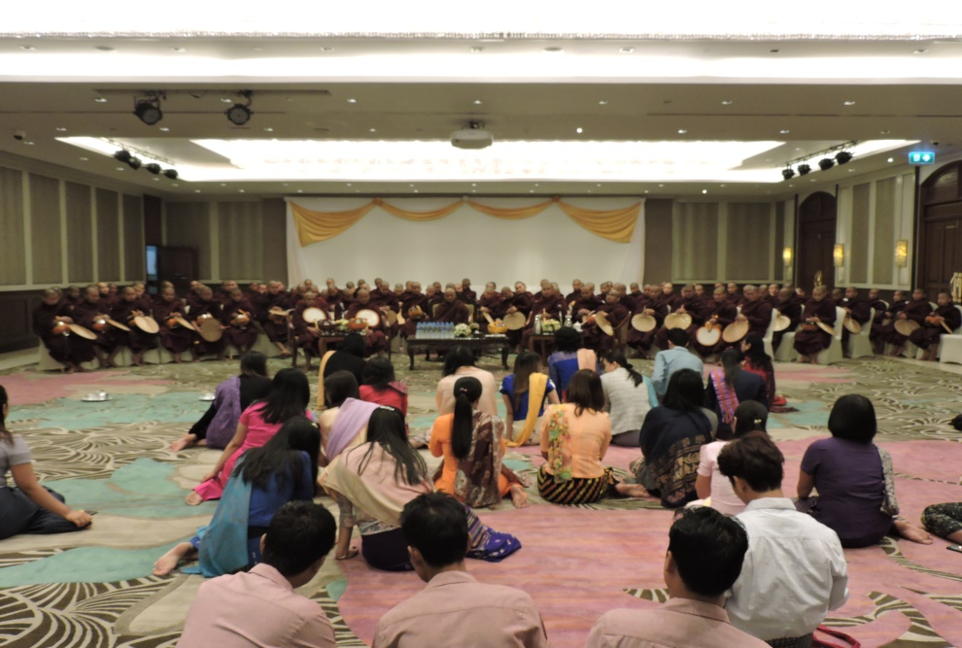
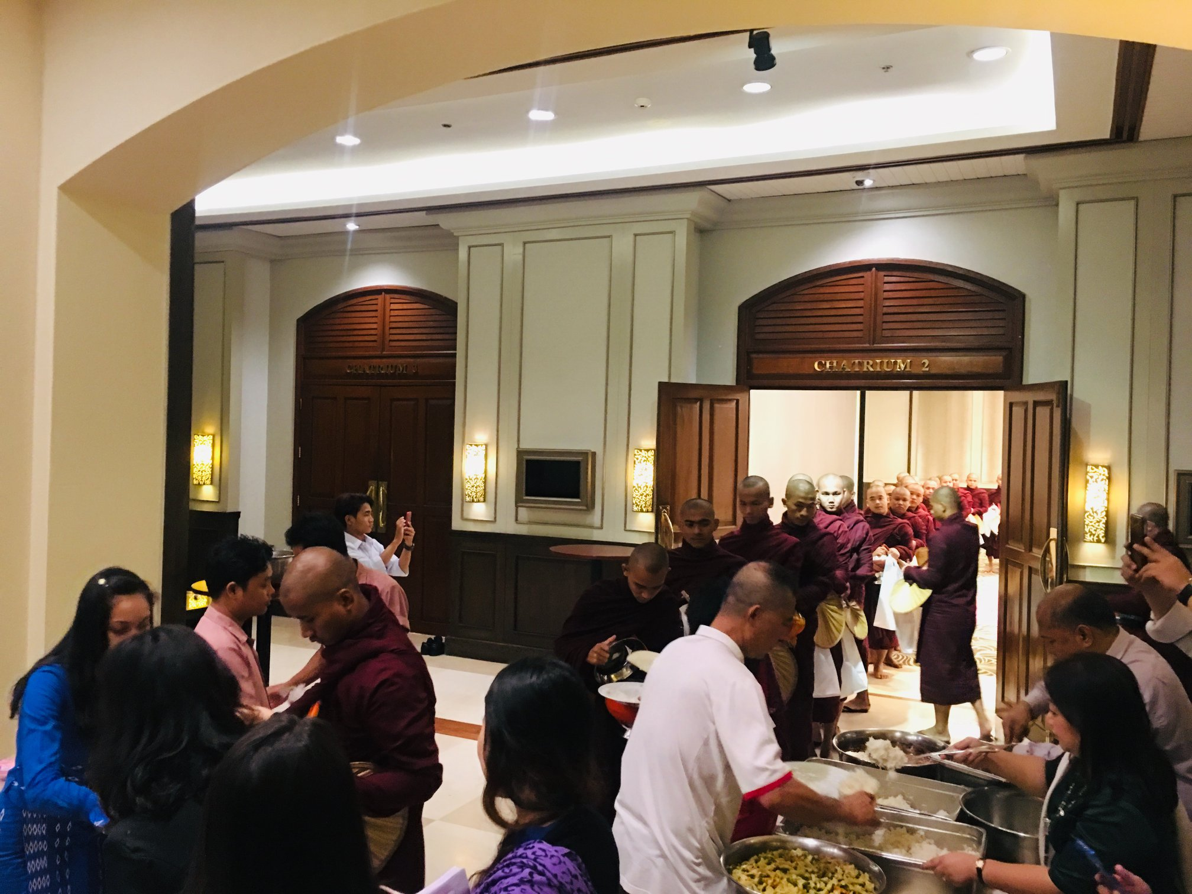
New Year Donation for monks

Slide 5
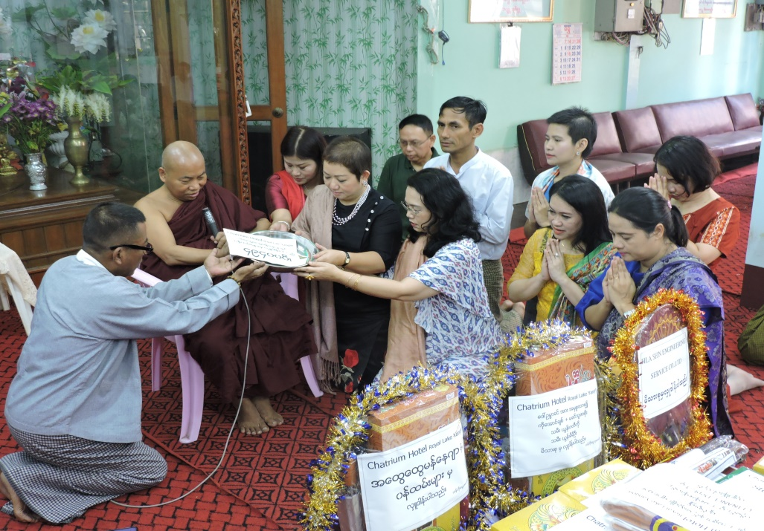
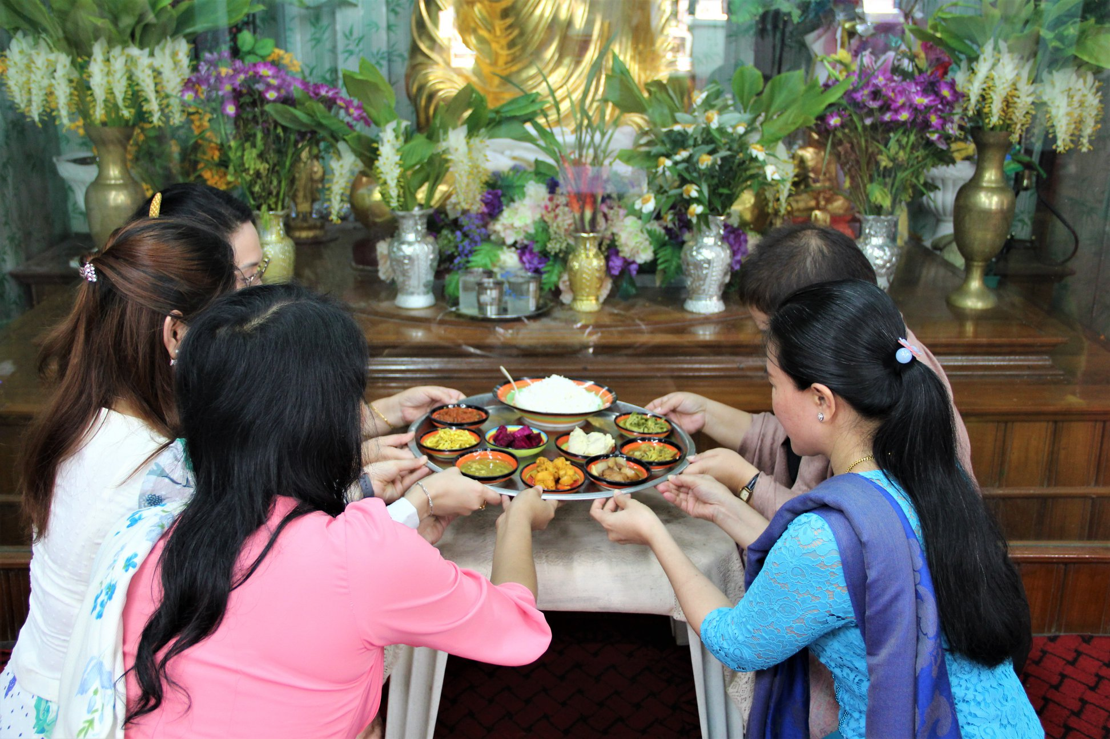
Waso Robe Donation

Slide 6
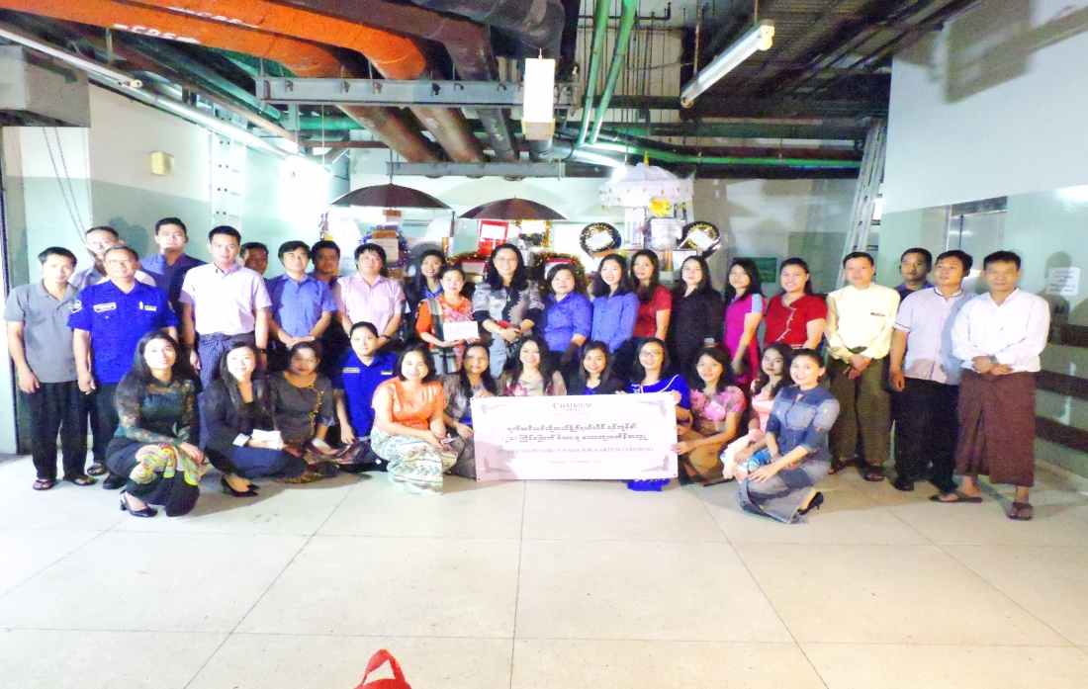
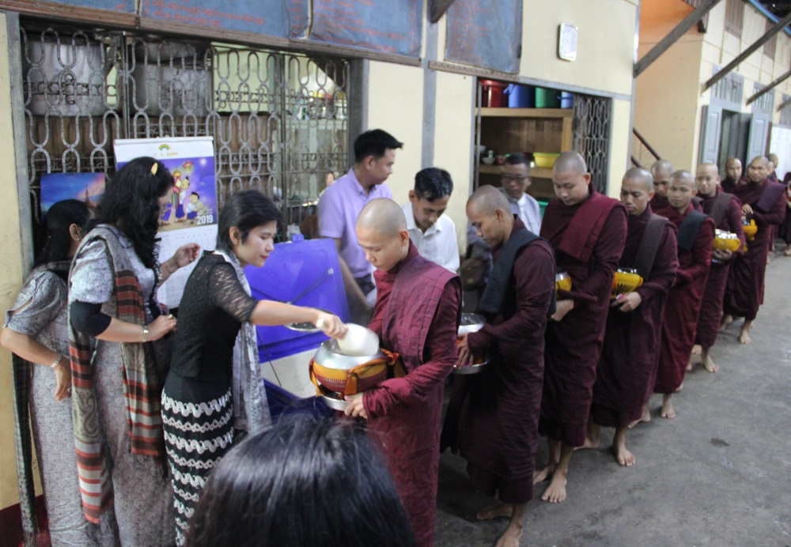
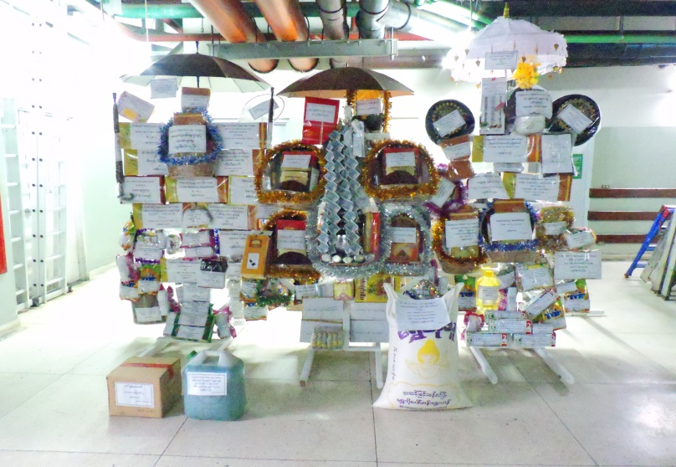
Kahtain Robe Donation

Slide 7
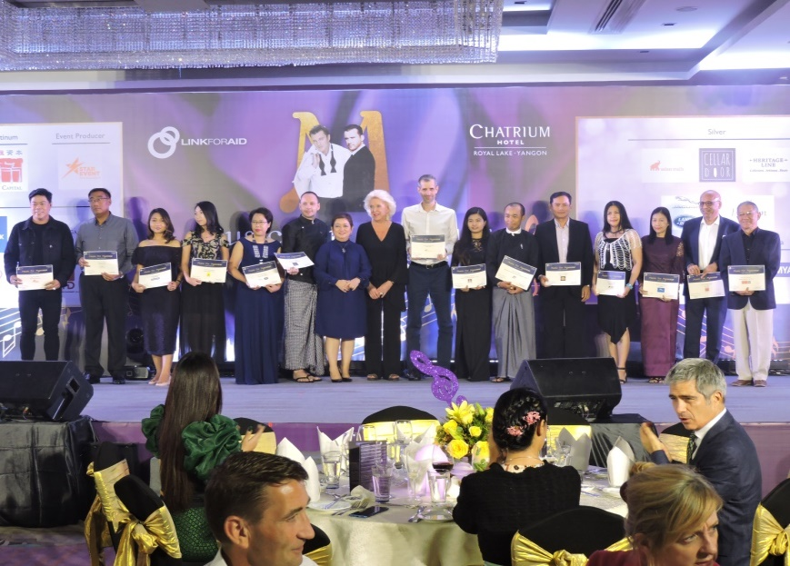
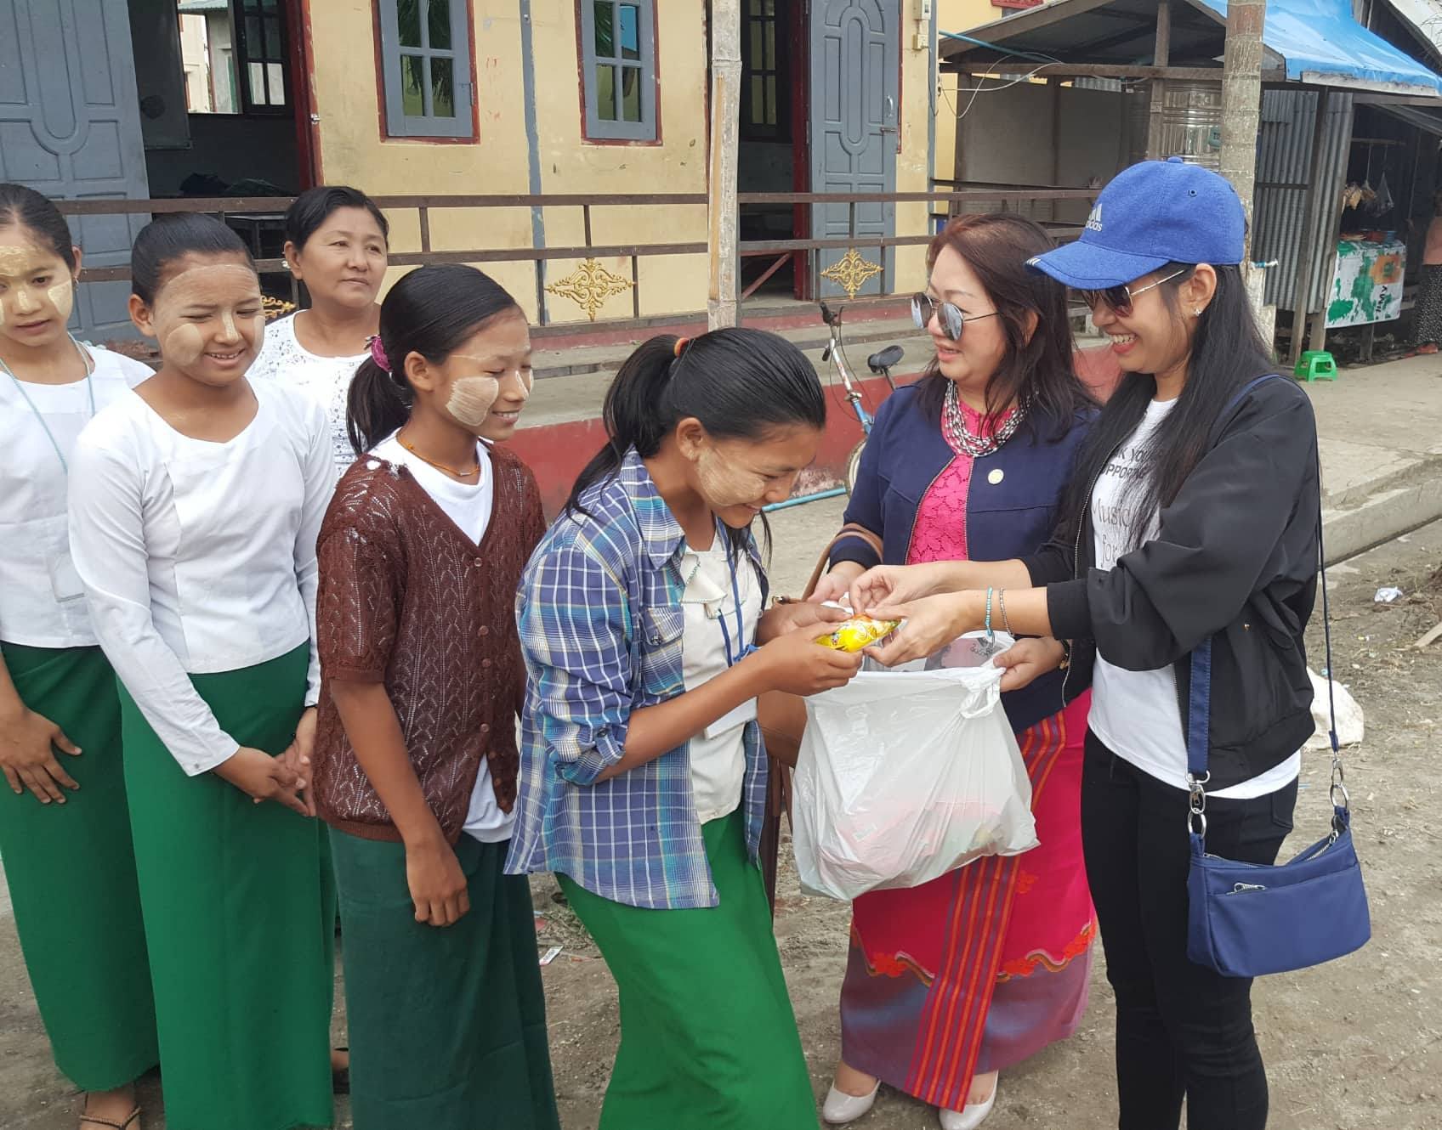
Music For Myanmar (Charity Event)
Chatrium Hotel Royal Lake Yangon and Link for Aid have organized this exciting charity evening to raise funds for projects aimed at improving the lives of disadvantage and vulnerable children in Myanmar.
The Mary Chapman school for the Deaf has over 350 students from all over Myanmar. Link for Aid funds projects designed to provide them with special skills, encourage their talents and enrich their lives
Supports New Humanity Myanmar - which provides health care for the rehabilitation of children with disabilities in Taunggyi and outlying villages and works with boys in a Yangon correctional detention center.
Supports projects to improve their living conditions and general welfare of over 70 children in the NAC NLD Aids Centre in Dagon Township, Yangon by contribution to their vital support networks and systems.

Slide 8
ENVIRONMENTAL CONTRIBUTIONS

Slide 9
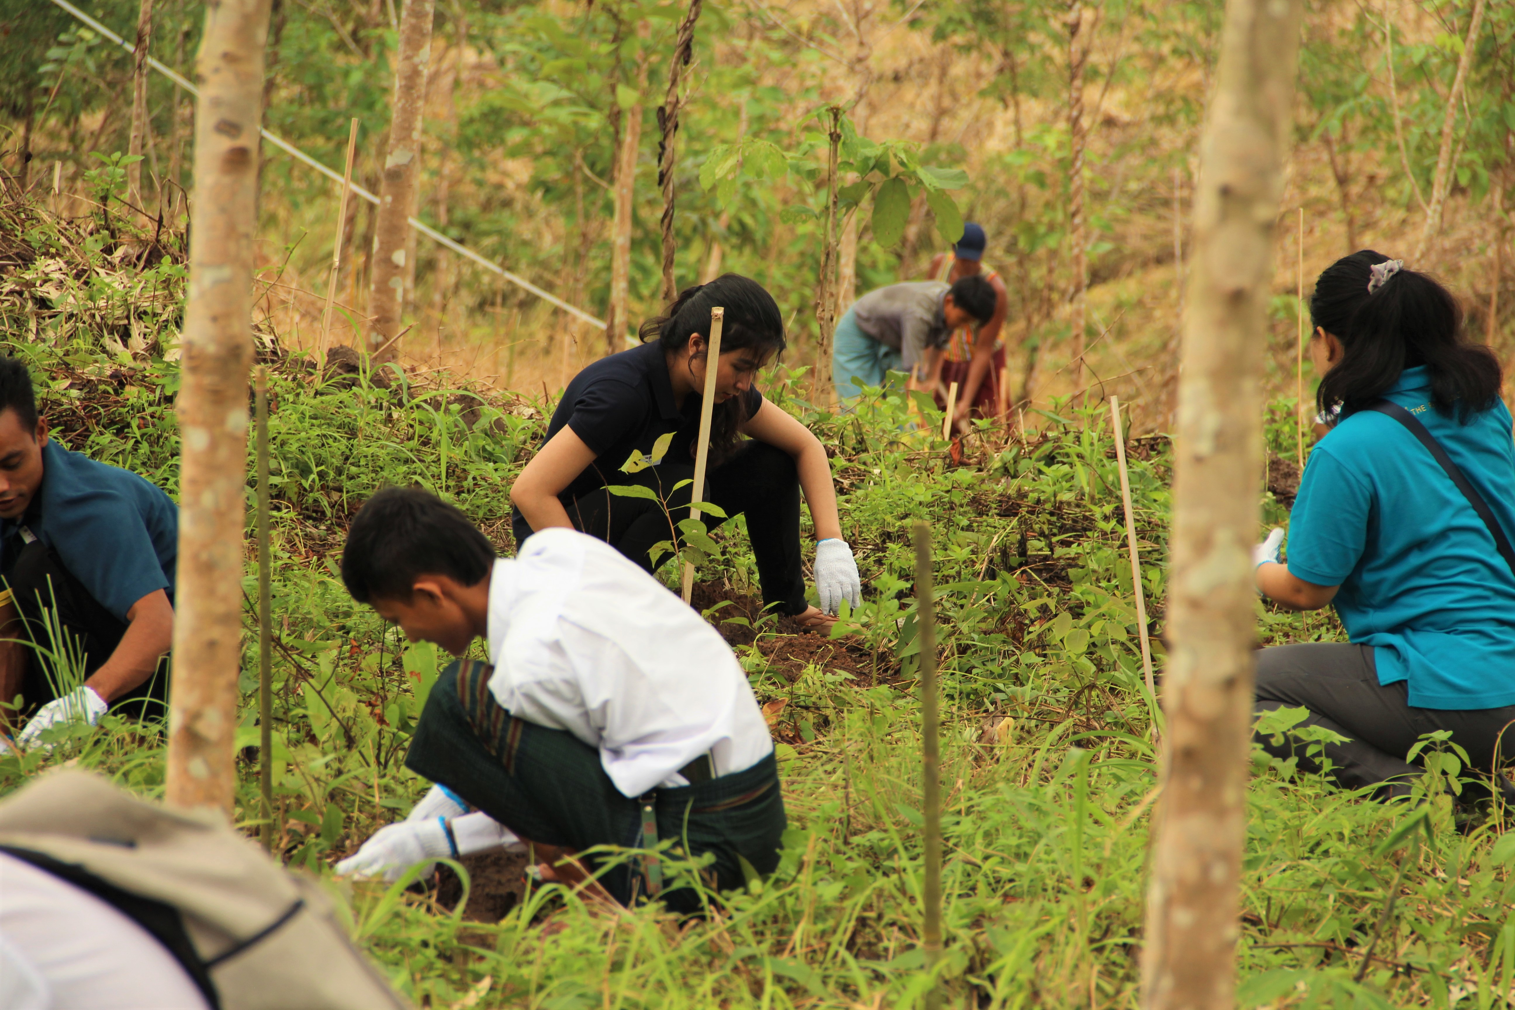
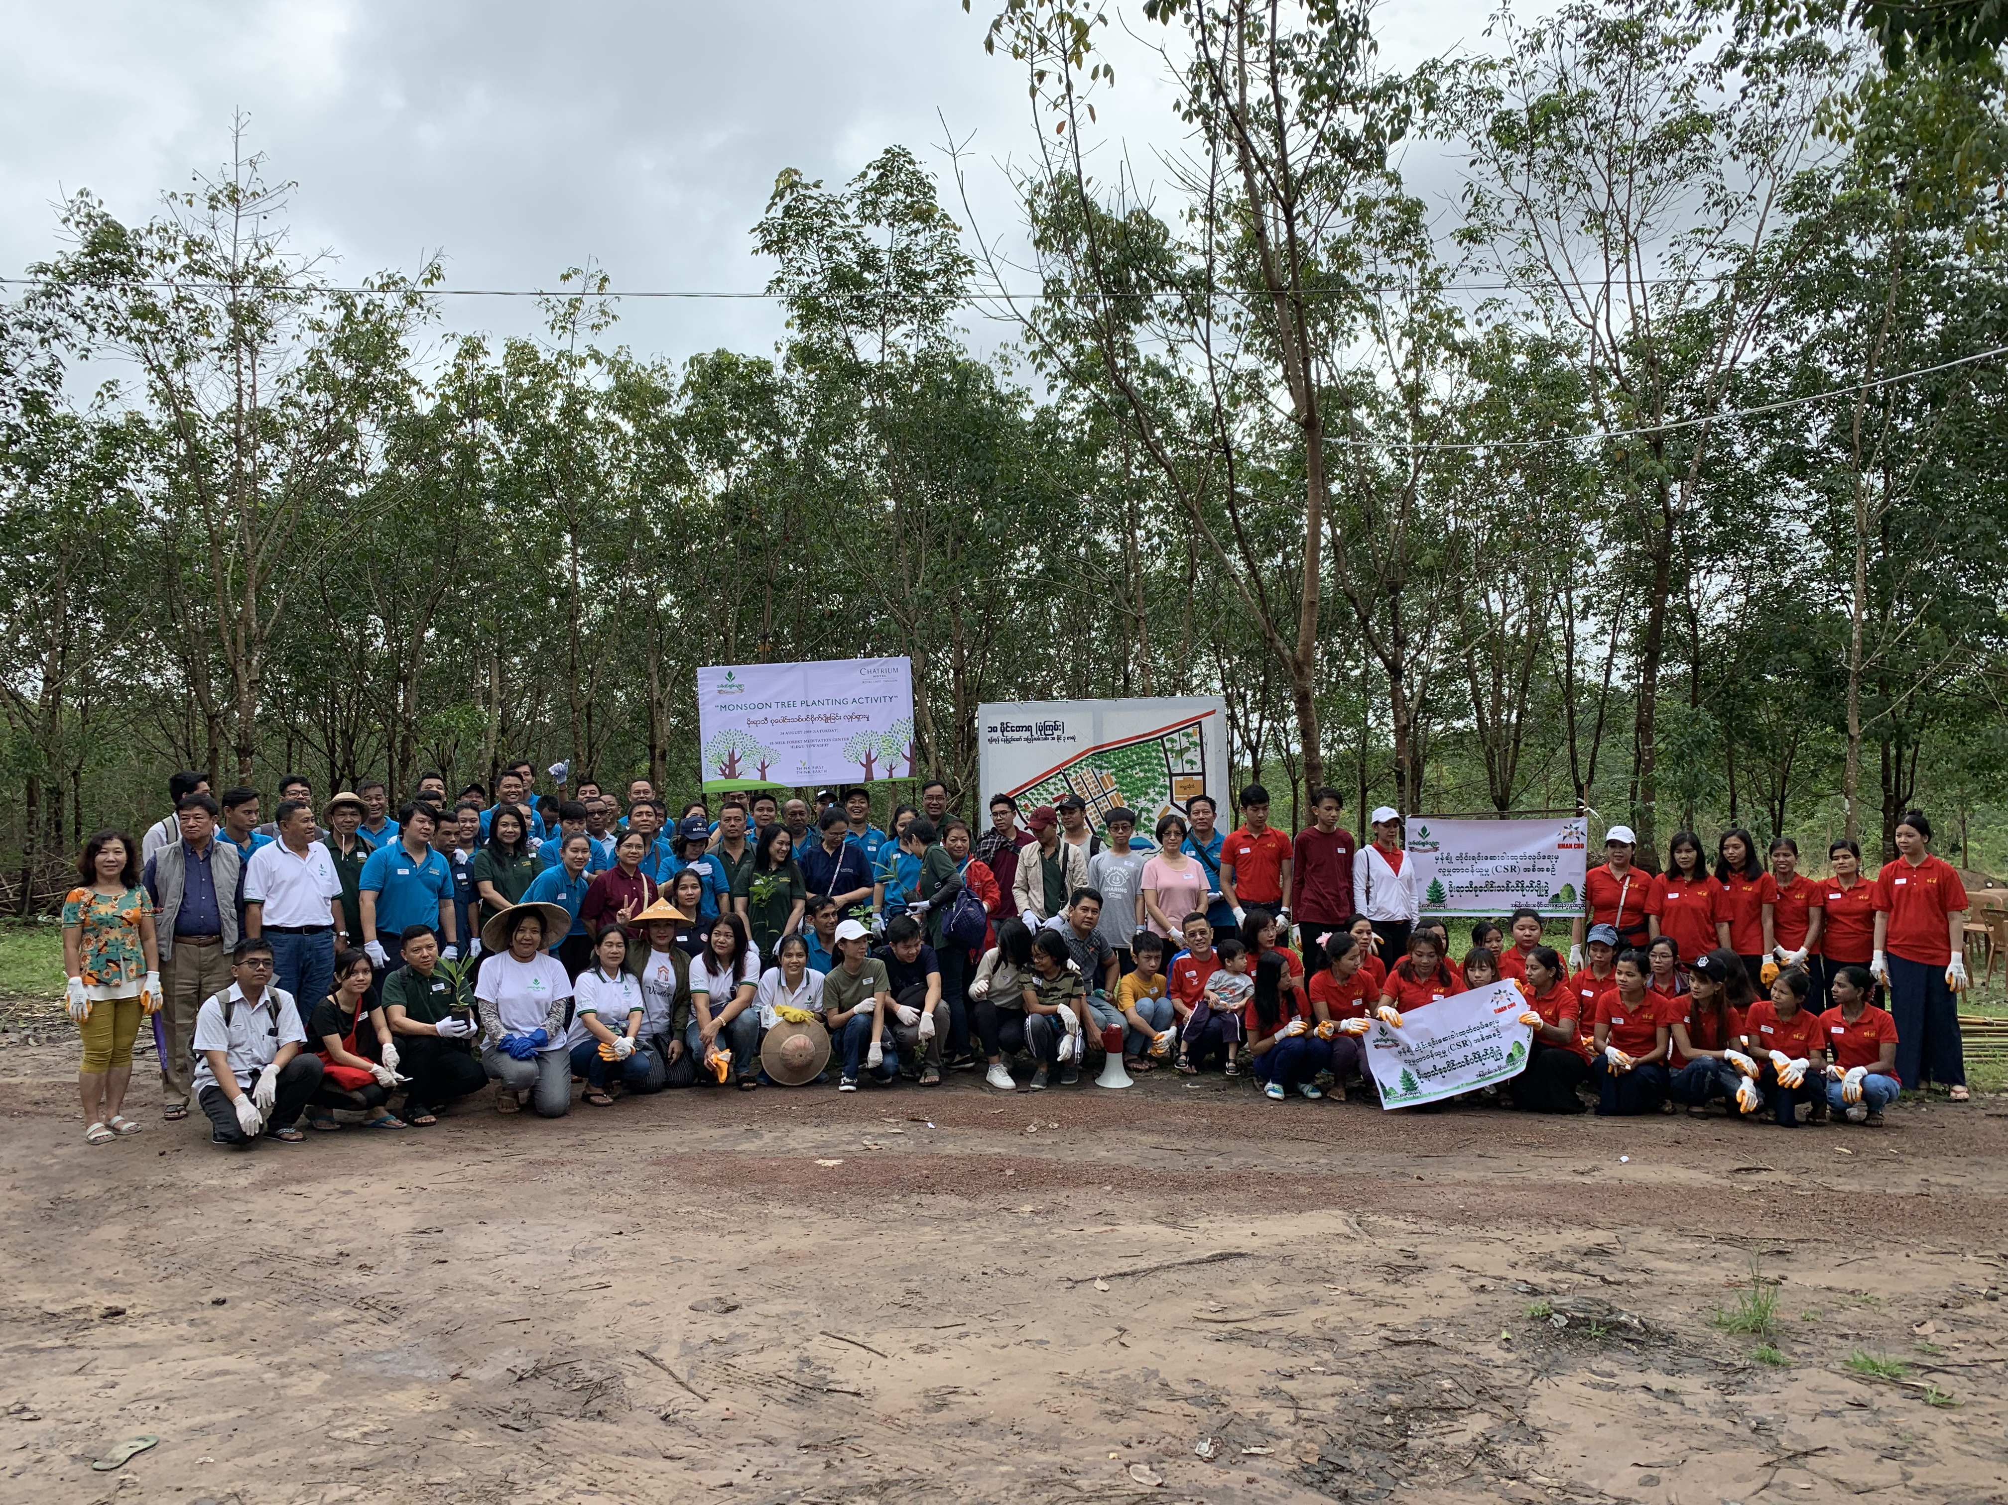
Trees Planting Activities
As part of Chatrium Hotel Royal Lake Yangon’s CSR activities and “Think First Think Earth” environmental initiatives, we undertake an annual tree planting activity to ease the harm and destruction of Mother Earth.
This year, we planted 3,000 trees at 18-Mile Forest Meditation Center near Yangon as part of our environmental commitment to the community to regenerate the environment and protect it from threatening natural disasters.

Slide 10
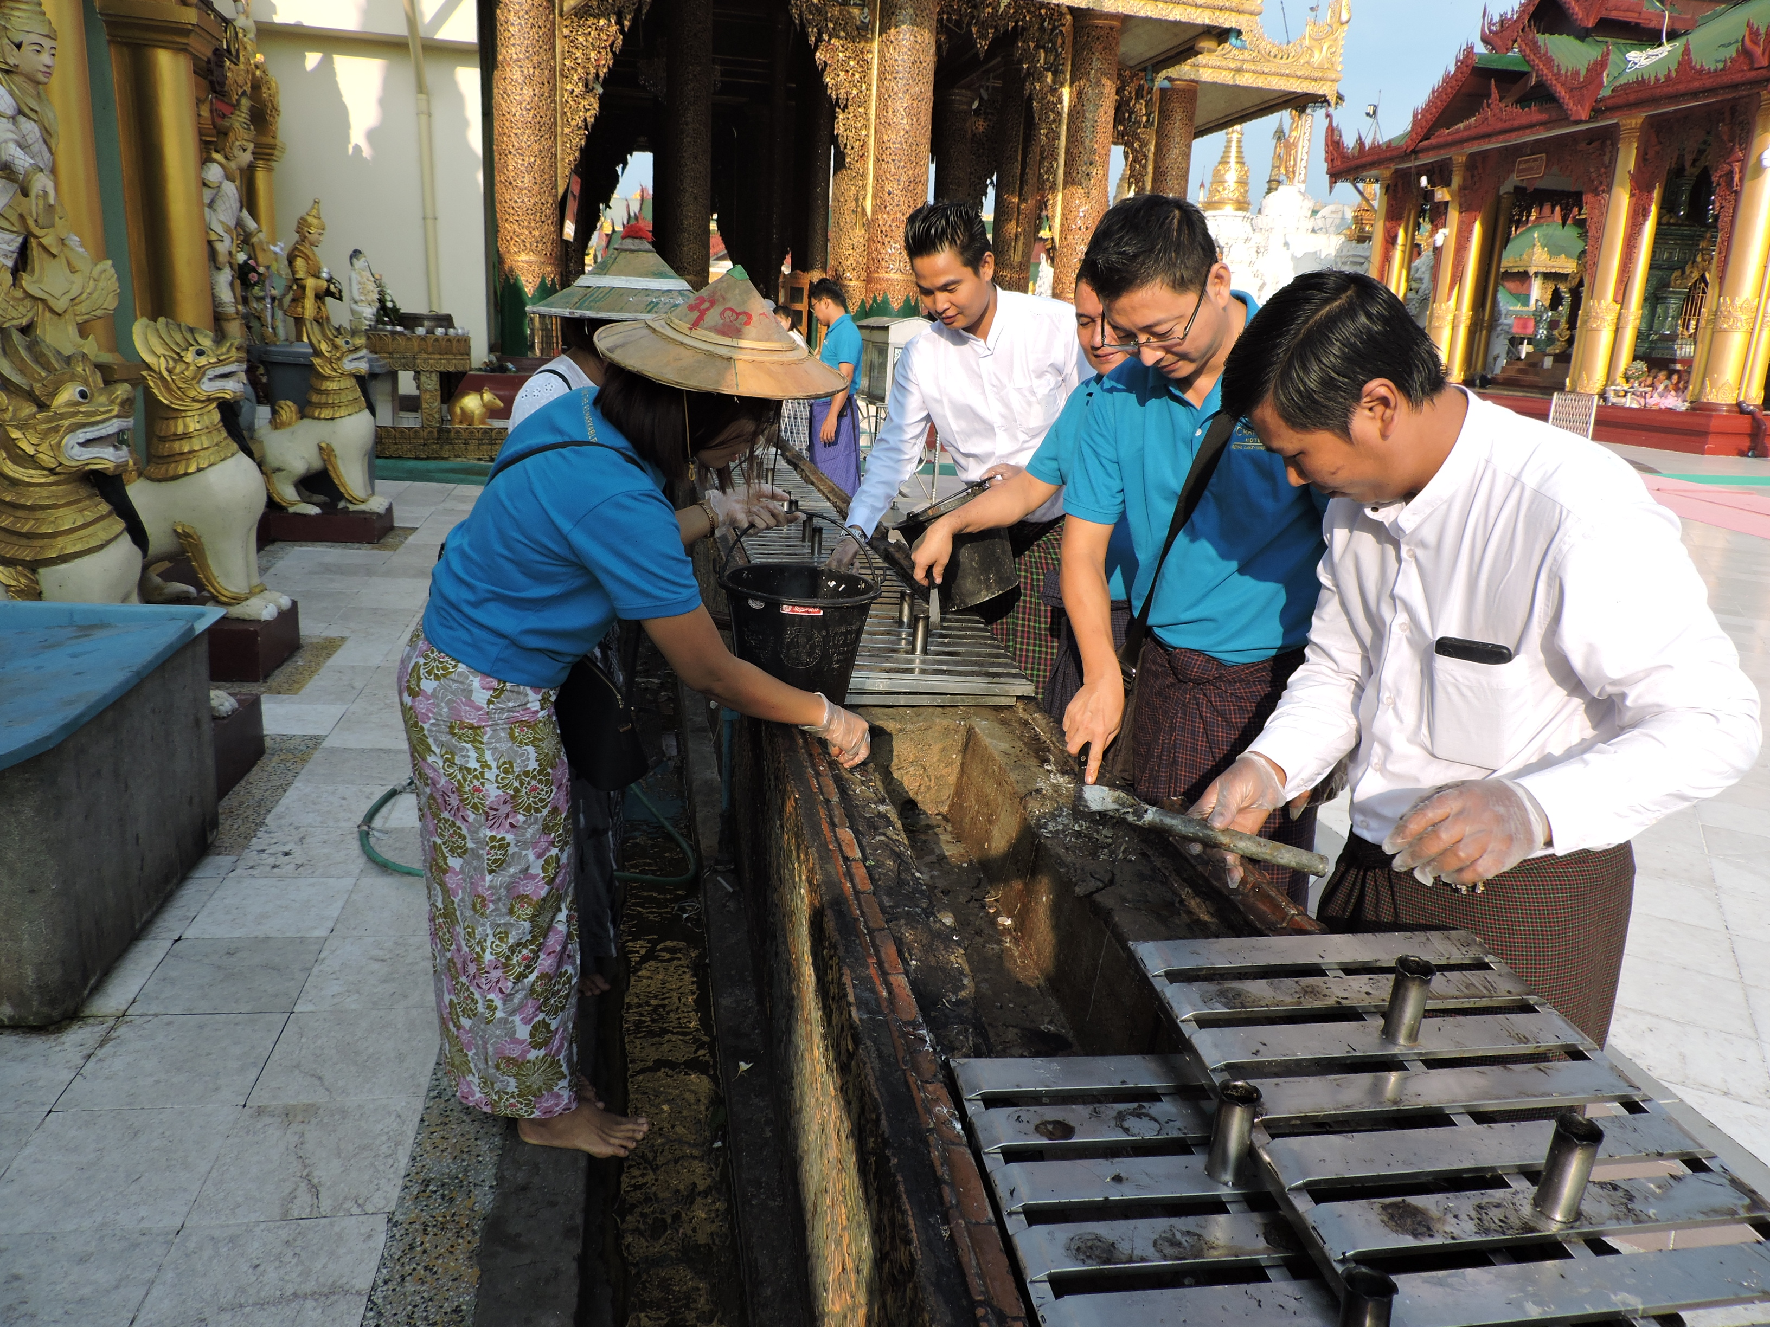
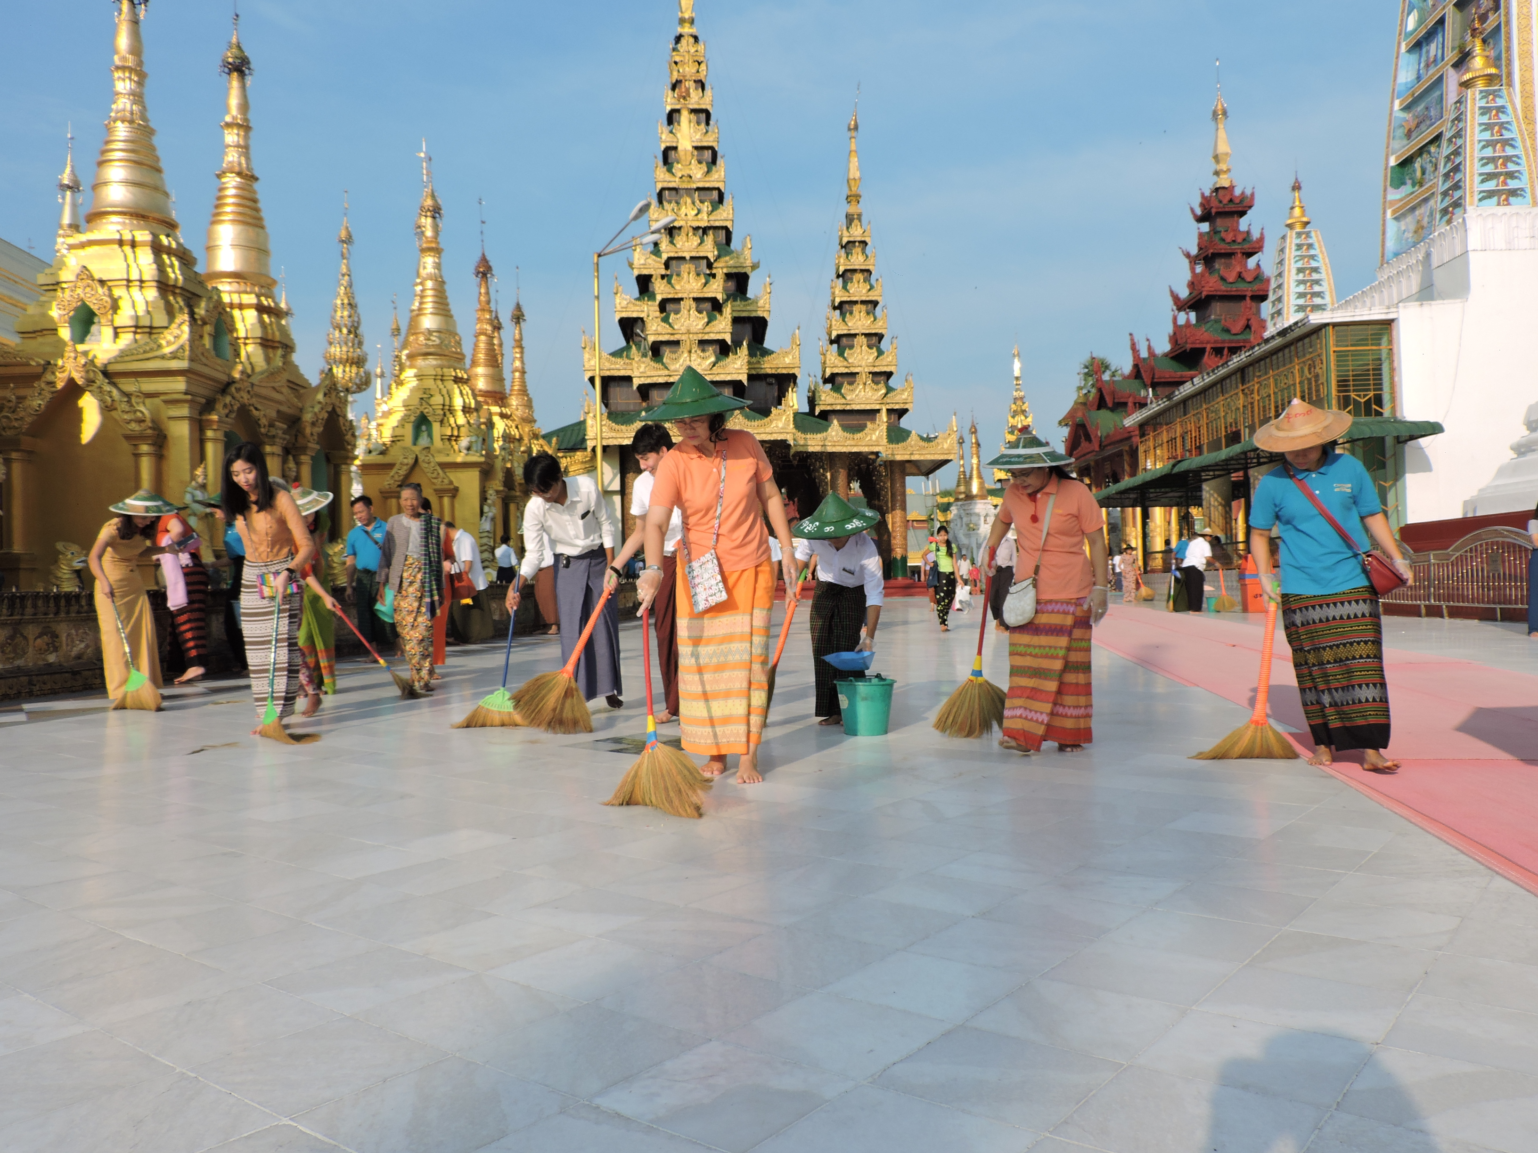
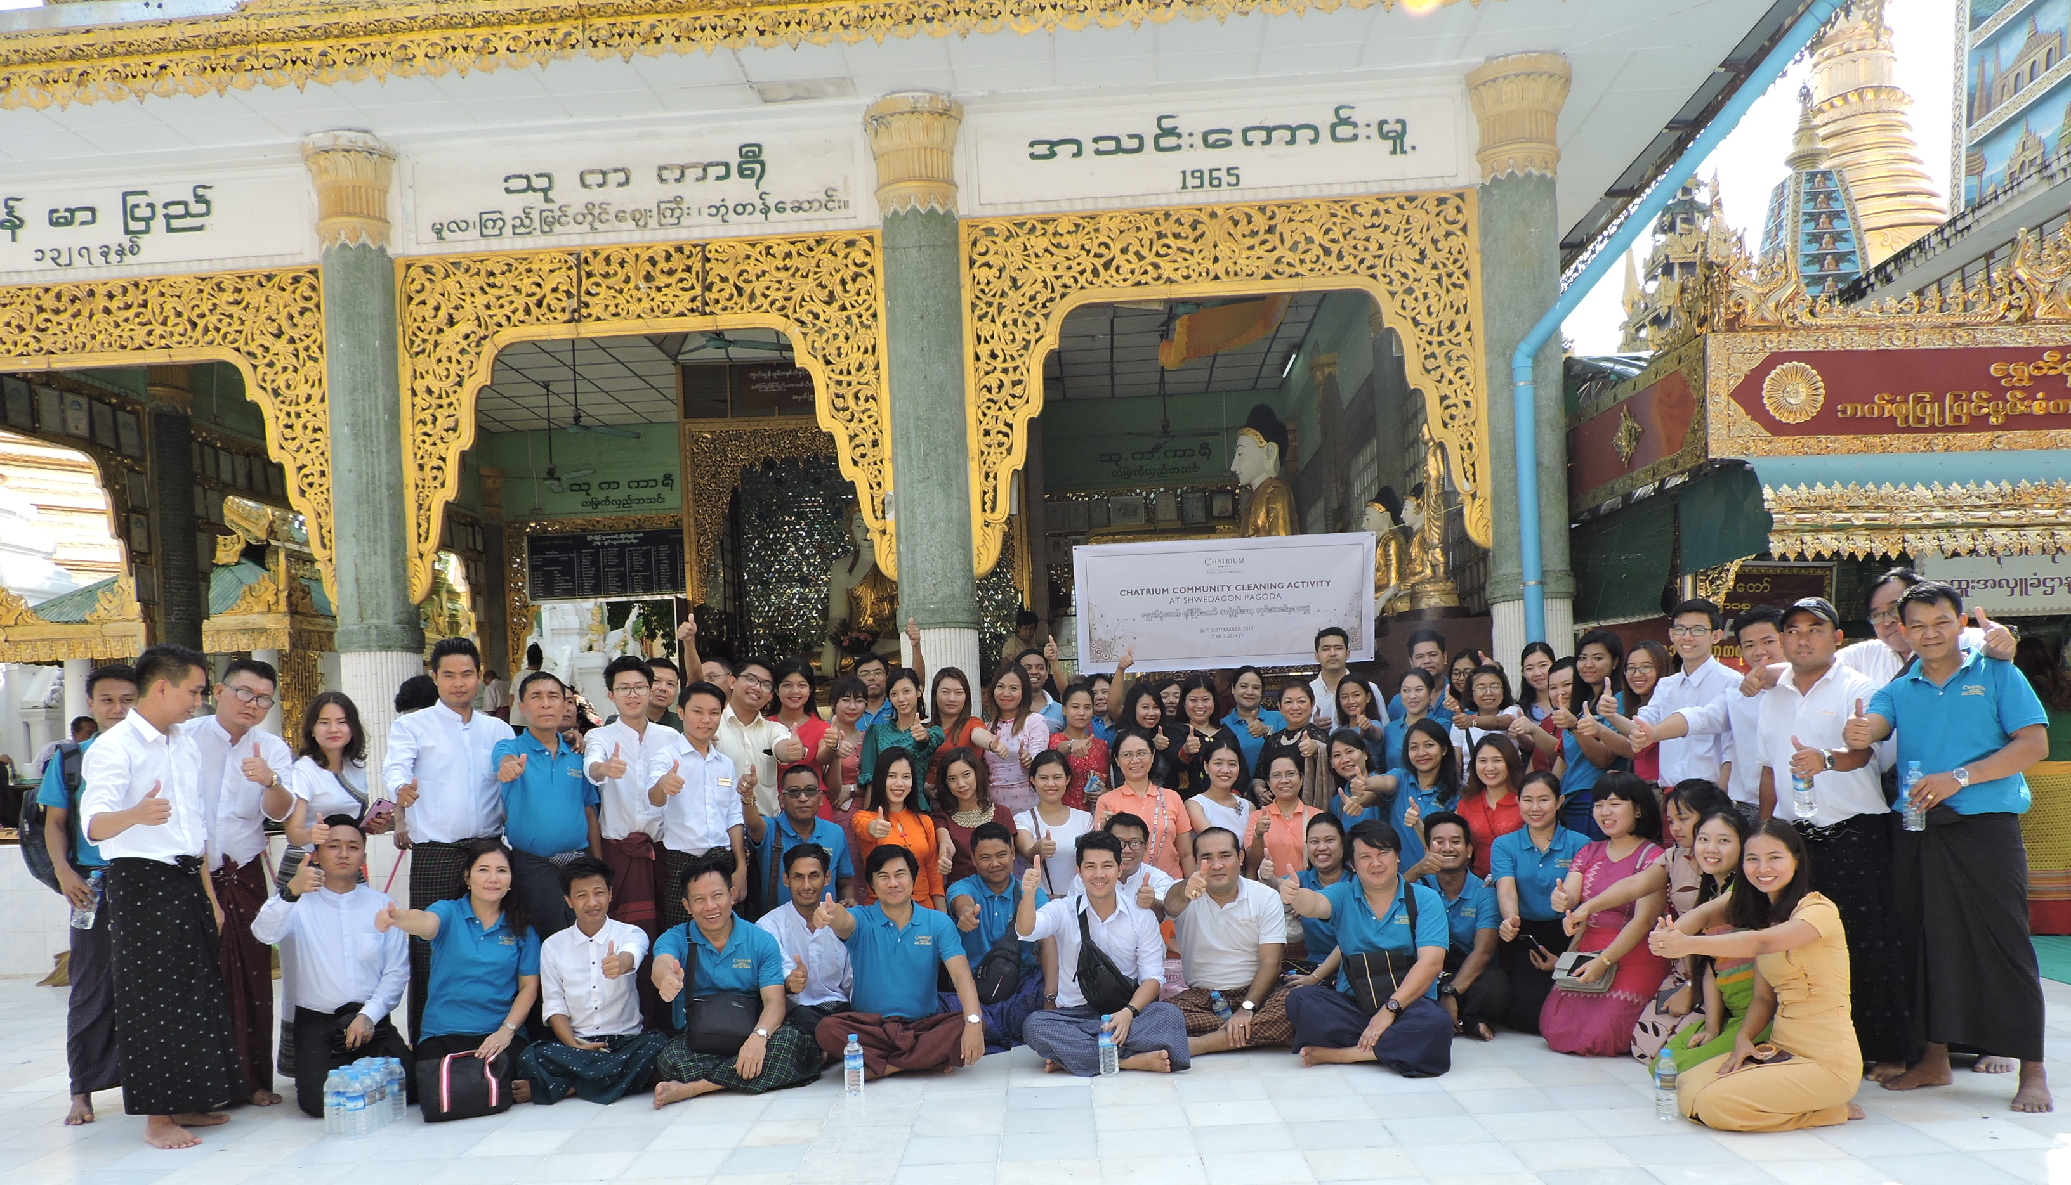
Community Cleaning Activity
As community cleaning activity, Chatrium Hotel Royal Lake Yangon family members swept the floor around the Pagoda and cleaned the waste wax at the Shwedagon Pagoda.

Slide 11
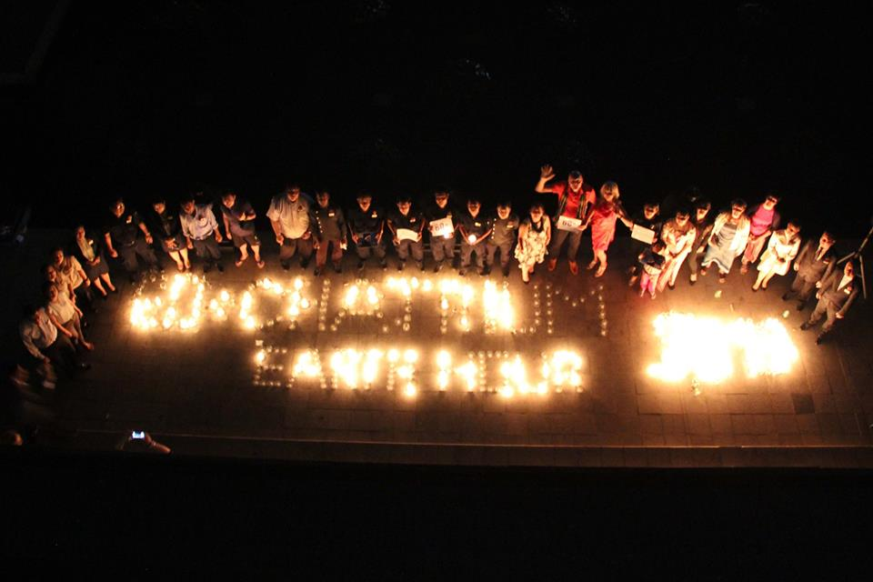
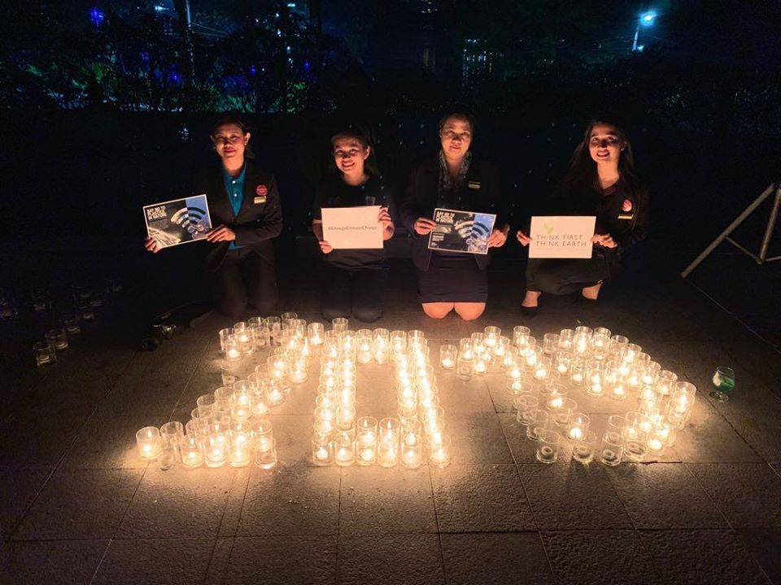
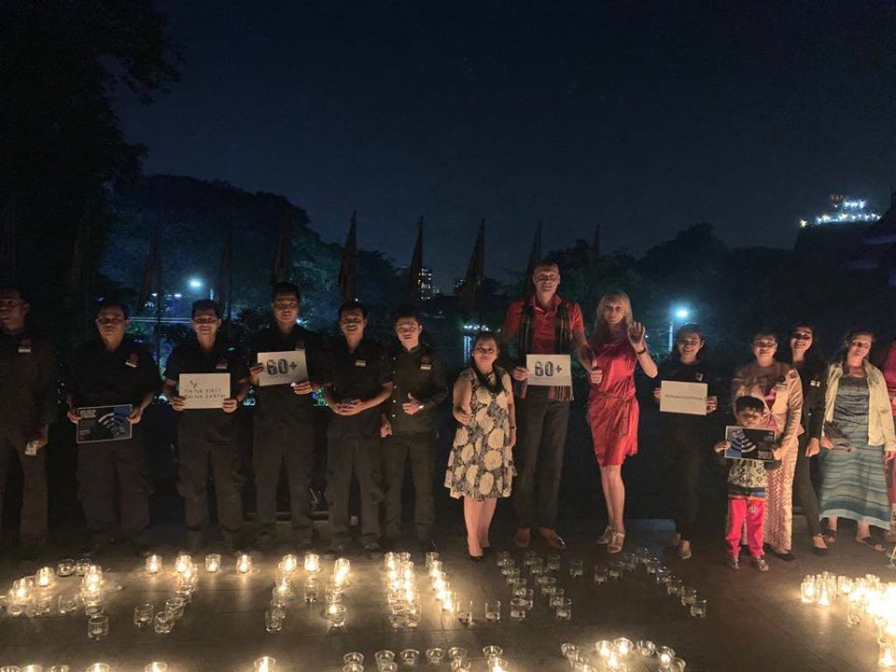
Chatrium Earth Hour
We joined this global initiative annually as part of our #ThinkFirstThinkEarth social responsibility and environmental initiative and we participate by switching off light for one hour from 8:30 pm to 9:30 pm local time on 30 March 2019 in Earth Hour 2019.

Slide 12
CSR Awareness Program

Slide 13
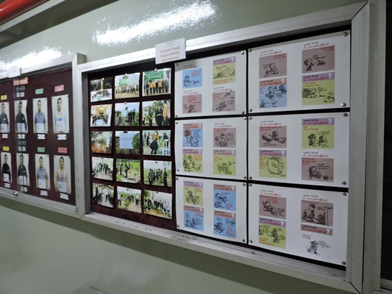
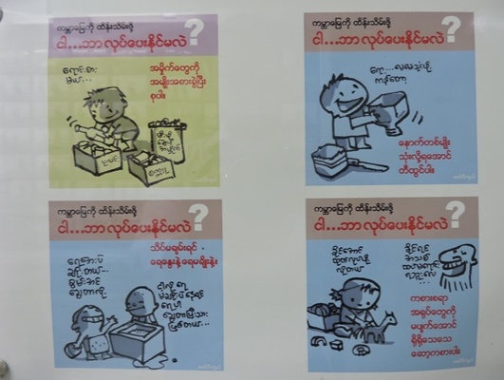
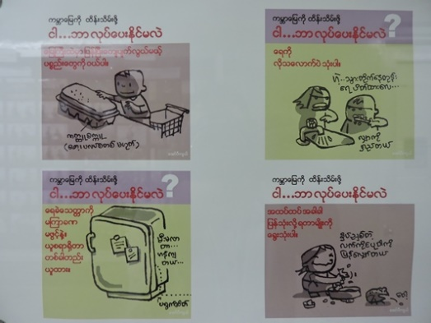
CSR Awareness Program for Chatrium Associates
For employee's awareness about Corporate Social Responsibility, photos, articles and cartoons concerning CSR knowledge posted on employee notice-board.

Slide 14
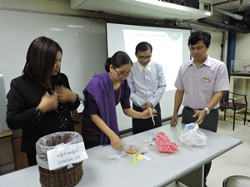
CSR Awareness Program, “Think First Think Earth” Training
All Chatrium associates were trained “Think First, Think Earth” Training Module 1, 2 ,3 which is included in Staff welcome orientation program.

Slide 15
GREEN INITIATIVE

Slide 16

“SKIP THE STRAW” Campaign

Slide 17
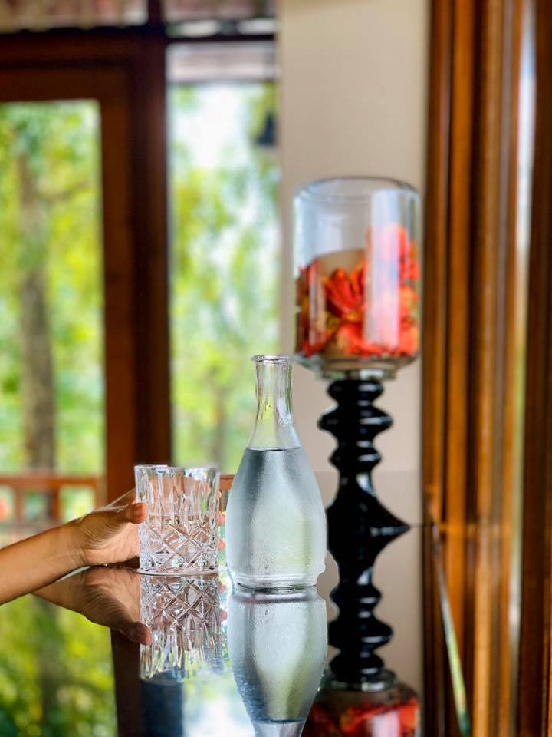
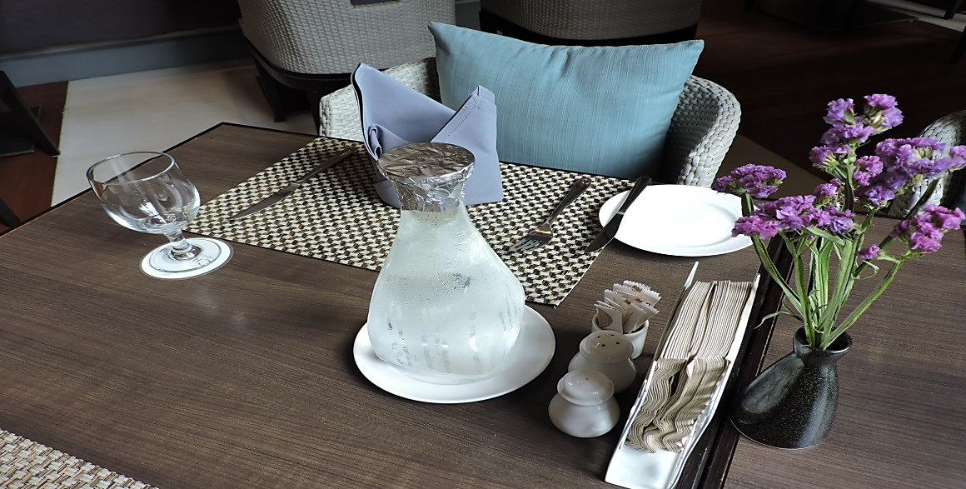
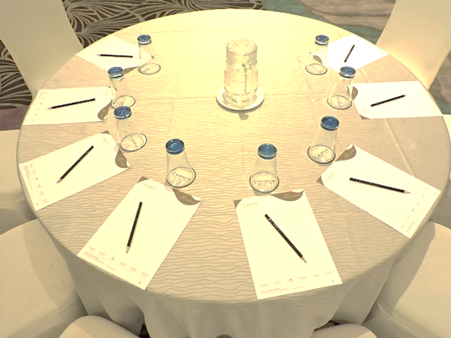
Reduce Plastic Bottles, Replace with Glass Jar and Glass Bottles
Chatrium Hotel Royal Lake Yangon
use glass jar and glass bottles to
provide drinking water in banquet
functions and all restaurants and reducing the usage of plastic bottles.

Slide 18
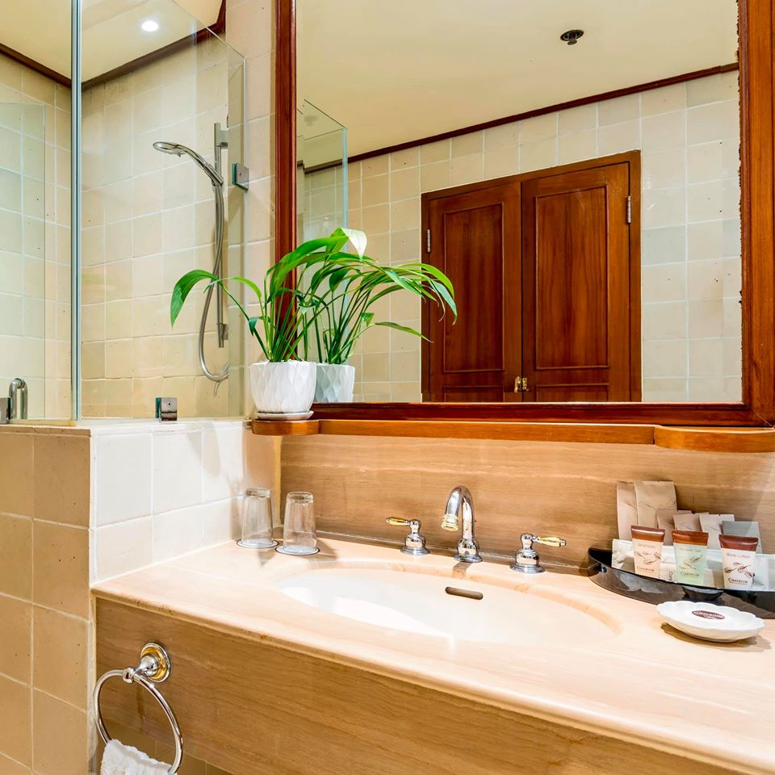
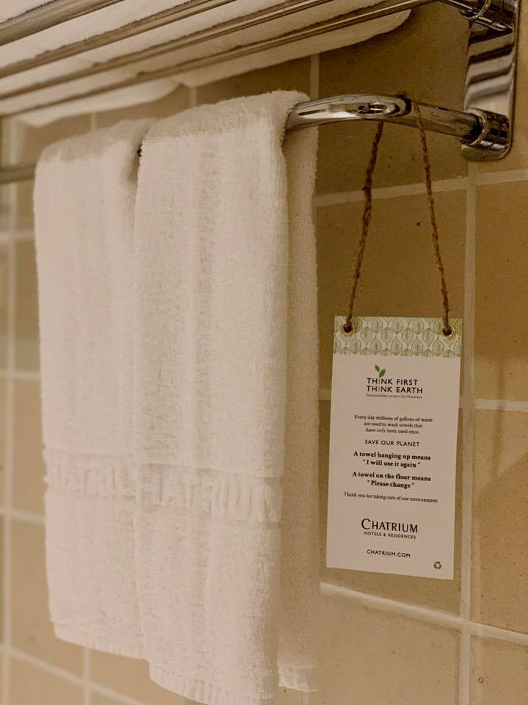
Using Recycle Bag, Biodegradable guest room amenities and “Think First Think Earth” Notice Cards

Slide 19
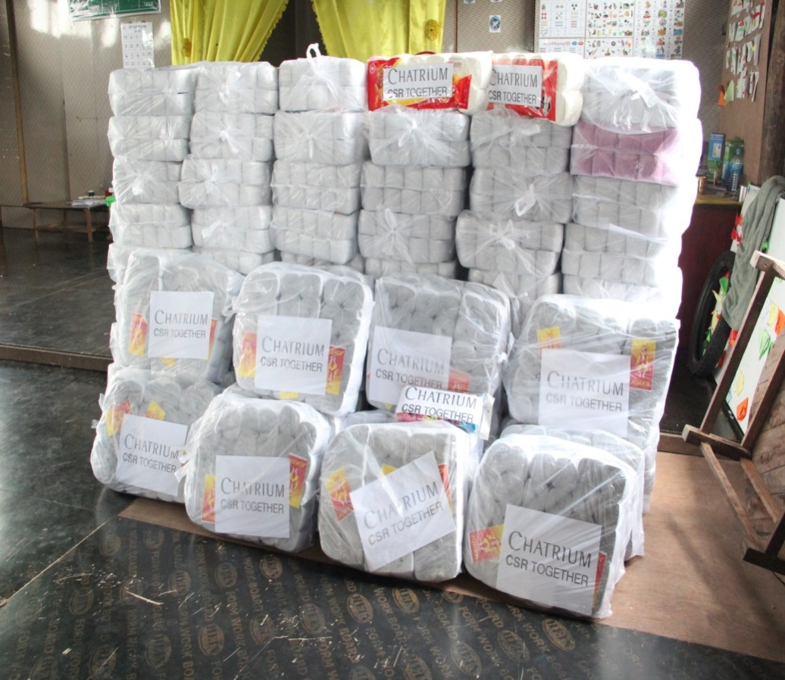
Recycling the old newspaper
We have started recycling old newspapers into tissue rolls and donated to orphanage schools.

Slide 20

Waste Segregation
General
Metal/Glass
Toxic
Plastic
We practice the sorting of garbage into Plastic, Metal / Glass, Toxic and General and also, we cautiously dispose the hazardous objects.

Slide 21
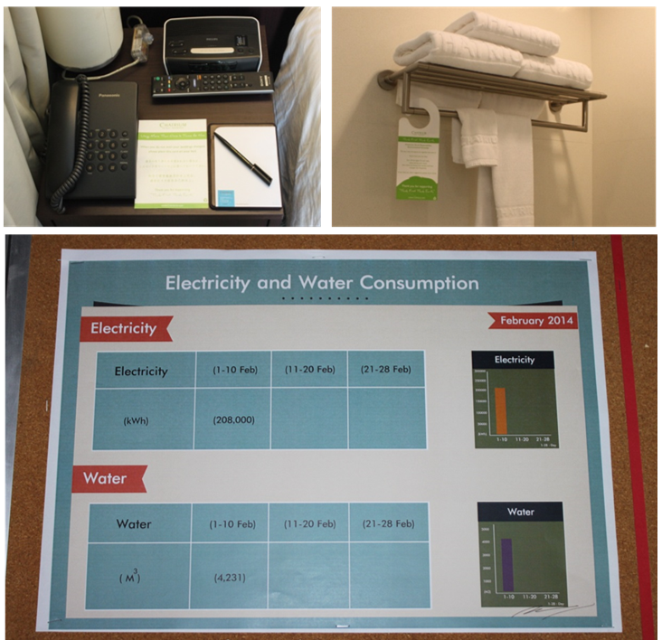
Energy Saving
Reducing Chiller Operating hours by monitoring usage
Reducing Air Con. Consumption by monitoring A/C system , installing timers and sub-meters.
Reducing electricity consumption by replacing with LED bulbs and LED florescent lamps
Energy and Water Saving Campaign with guests
Energy saving bulbs and aerators are installed
Report the cost of Electricity, Water and Gas on monthly basis

Slide 22
SUPPORT EDUCATION &
PEOPLE’S DEVELOPMENT

Slide 23
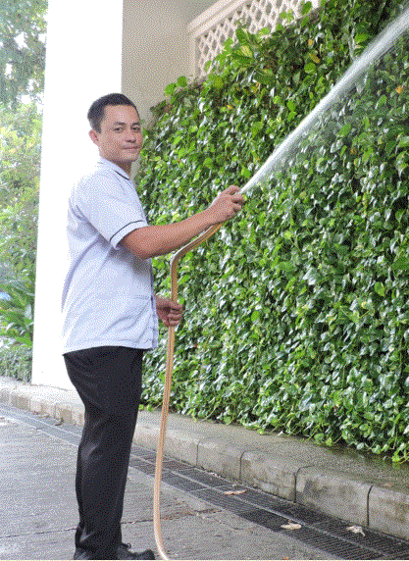
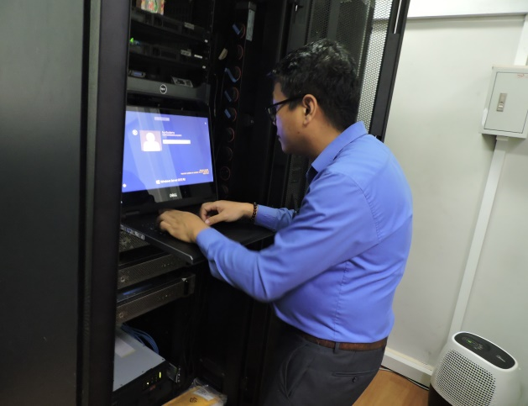
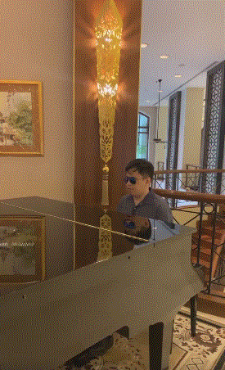
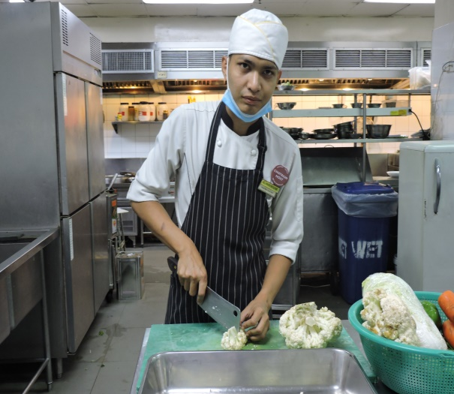
Chatrium give equal employment opportunity to the underprivileged people
We have appointed four numbers of disabled people as our employees; two deaf and dumb colleagues who are in the Kitchen and Housekeeping Department, one person who has spinal cord deformity as an IT manager and one blindness is as a pianist from the Front Office Department. They are hard-working yet talented, and some have also been selected as employees of the month.

Slide 24
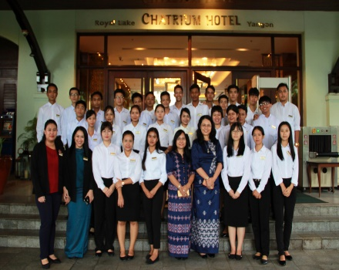
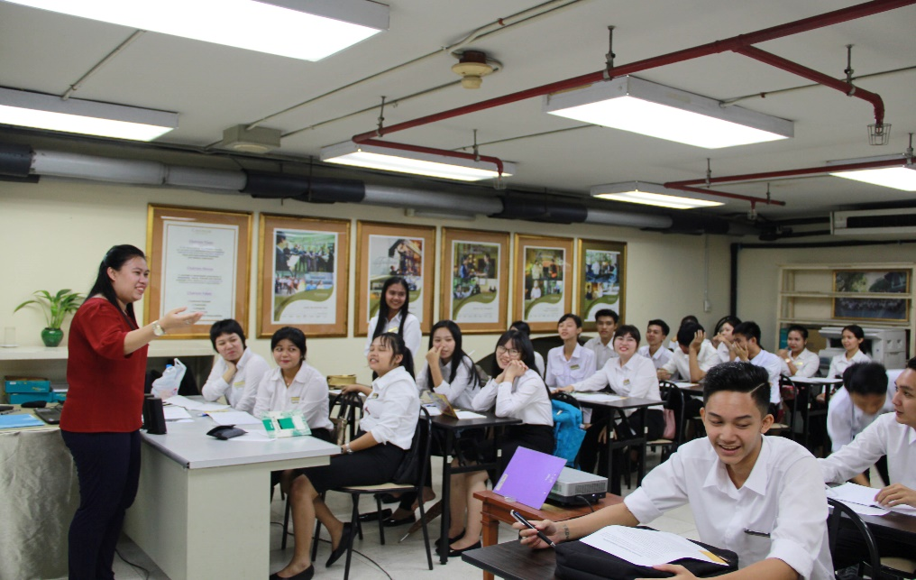
Hospitality Training Program
Chatrium Hotel Royal Lake Yangon focuses on the development of human capital by developing and implementing the Hospitality Training Program to generate employment opportunities for young people and to deliver skilled labor in the Hospitality Industry.

Slide 25
Internship Program
We accepted total 85 interns from the following organizations during the year from the following schools & organizations
Daw Khin Kyi Foundation
HTMi Hotel & Tourism Management Institute Switzerland
Myanmar Luxembourg Development Cooperation
Mandalar Degree College
MBA
Myittat A Lin Food & Beverage Vocational Training
Swiss Contact
Yangon University of Economic
National Management Degree College
CVT- Centre for Vocational Training

Slide 26
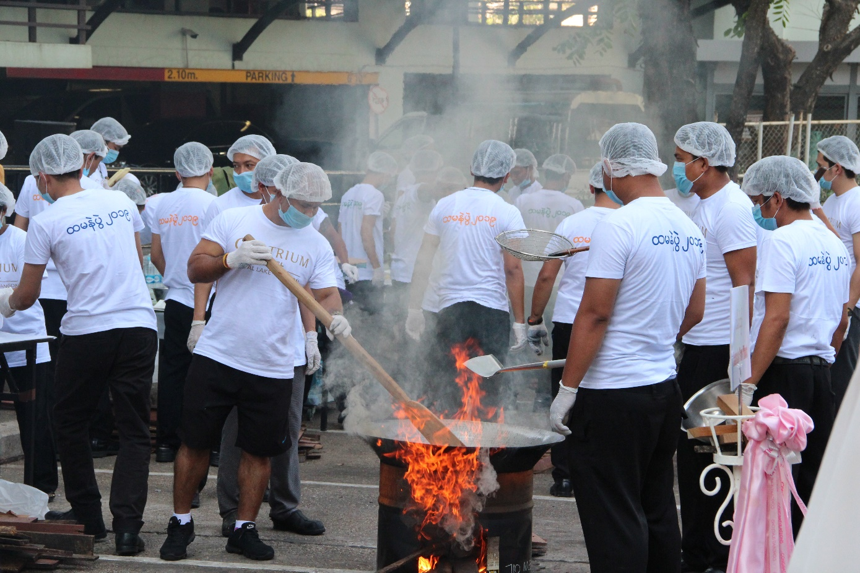
Promote Myanmar Culture-Traditional Sticky Rice Making Competition - 2019
To promote Myanmar Culture and as part of the Hotel team-building program, Chatrium Myanmar Traditional Sticky Rice Making Competition (Hta-ma-ne Pwe) was held in the month of February 2019.
“Engagement and Teamwork” are parts of our code of conduct at Chatrium. This Htamane competition helped us strengthening our teamwork and added more engagement in order to fulfill our customer satisfaction.

Slide 27
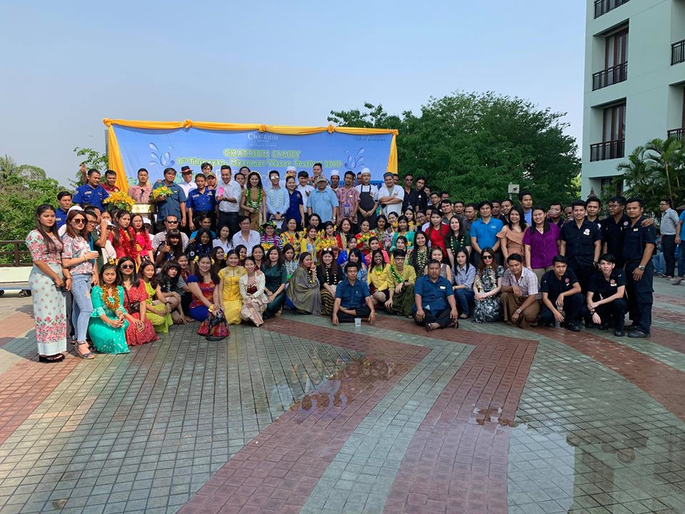
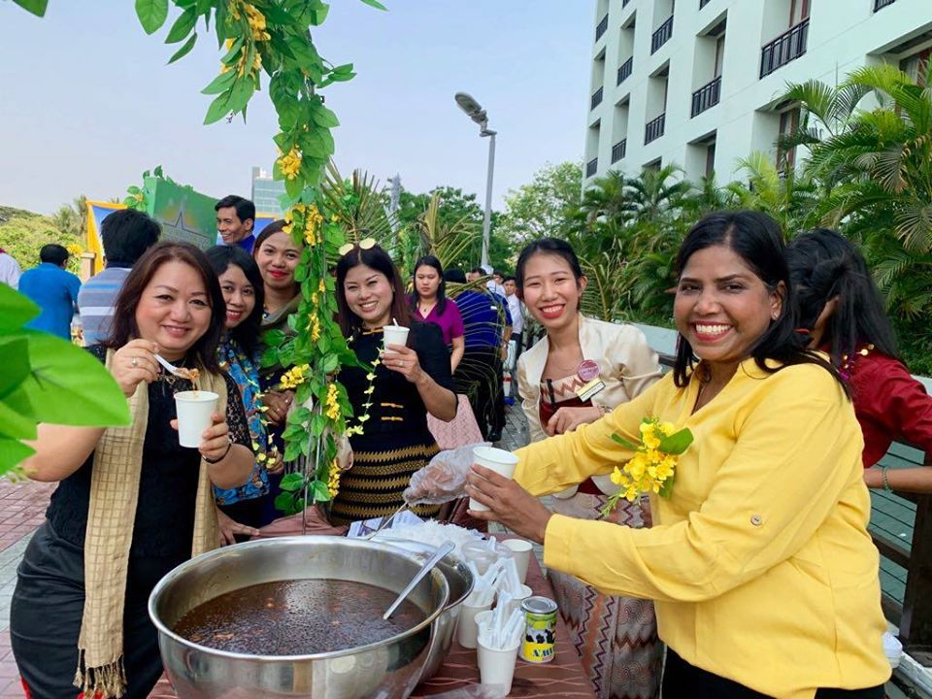
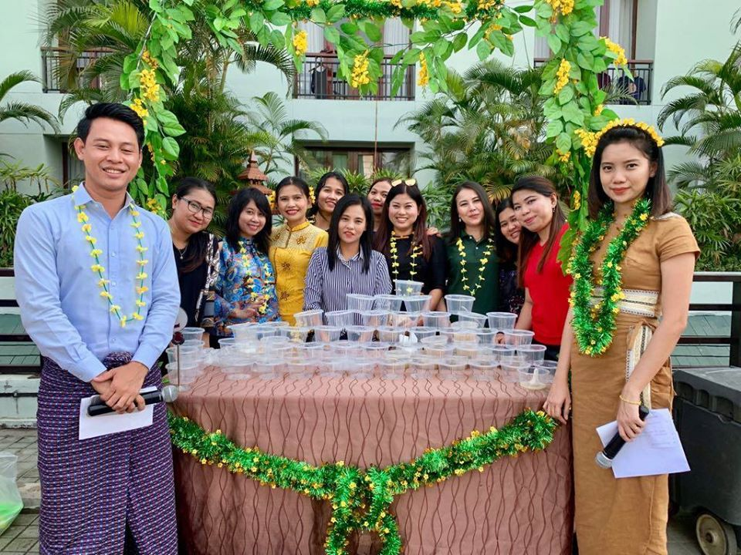
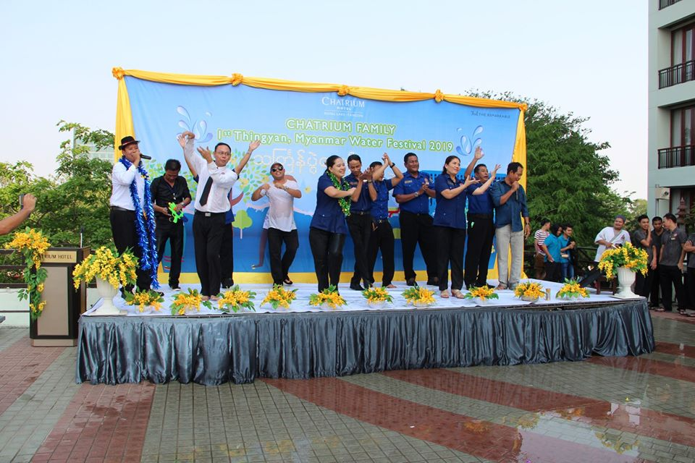
Promote Myanmar Water Festival (Thingyan Festival)

Slide 28
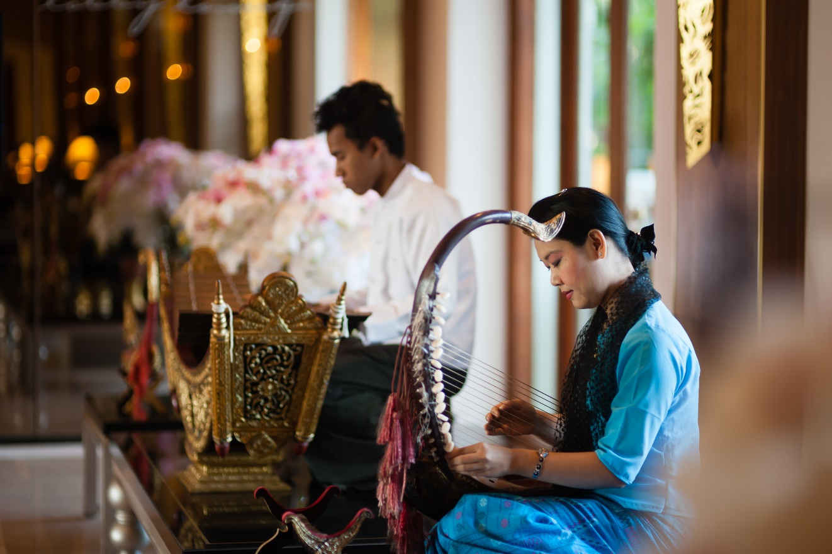
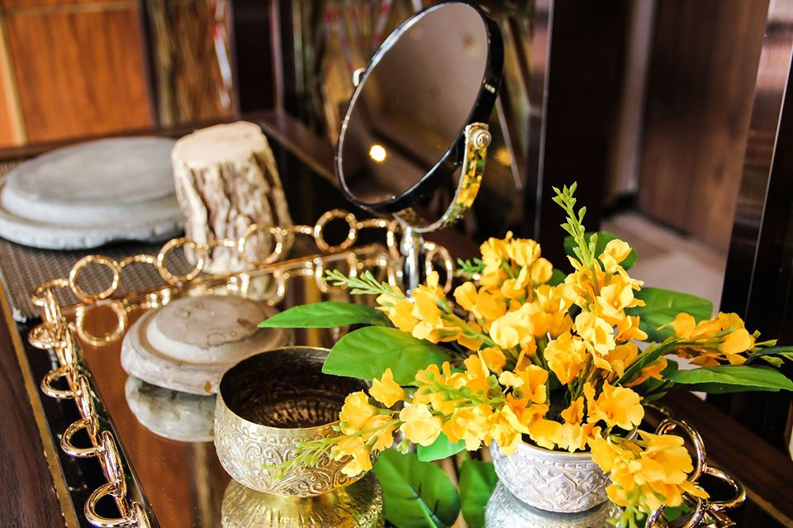
Tha-nat-kha Station, and music played by Myanmar musician with Myanmar musical instrument, “harp” in the lobby lounge

Slide 29
