Slide 1
United Nations Global Compact
Communication of Progress
Al Masah Capital Limited
August 2019

Slide 2
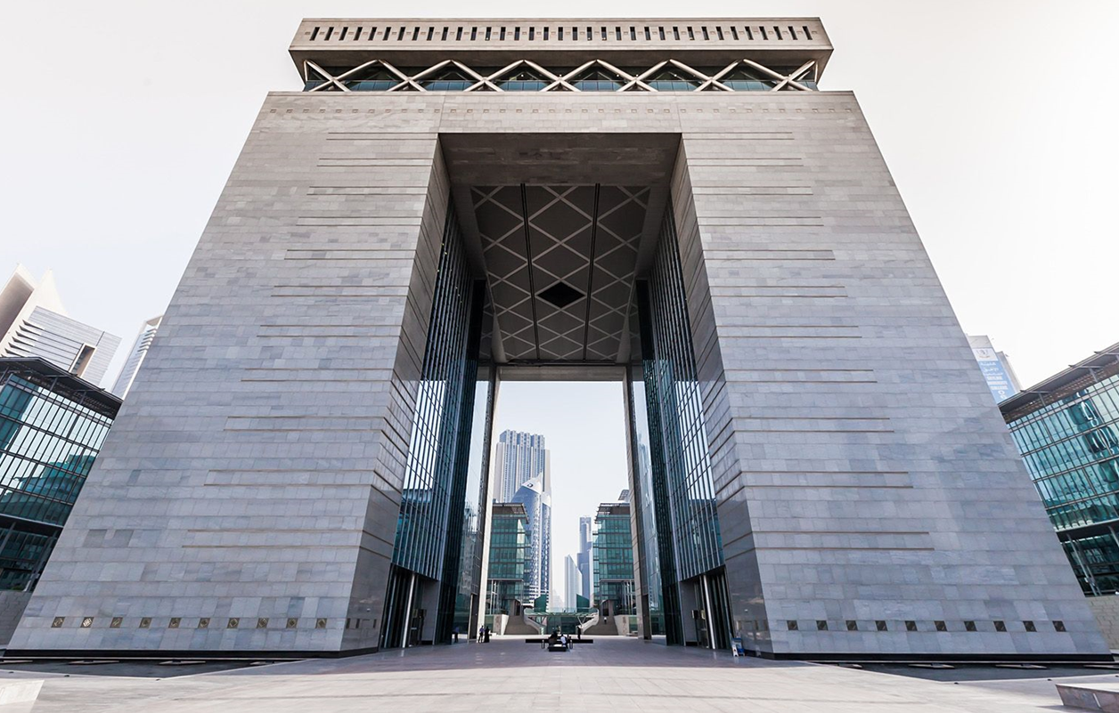
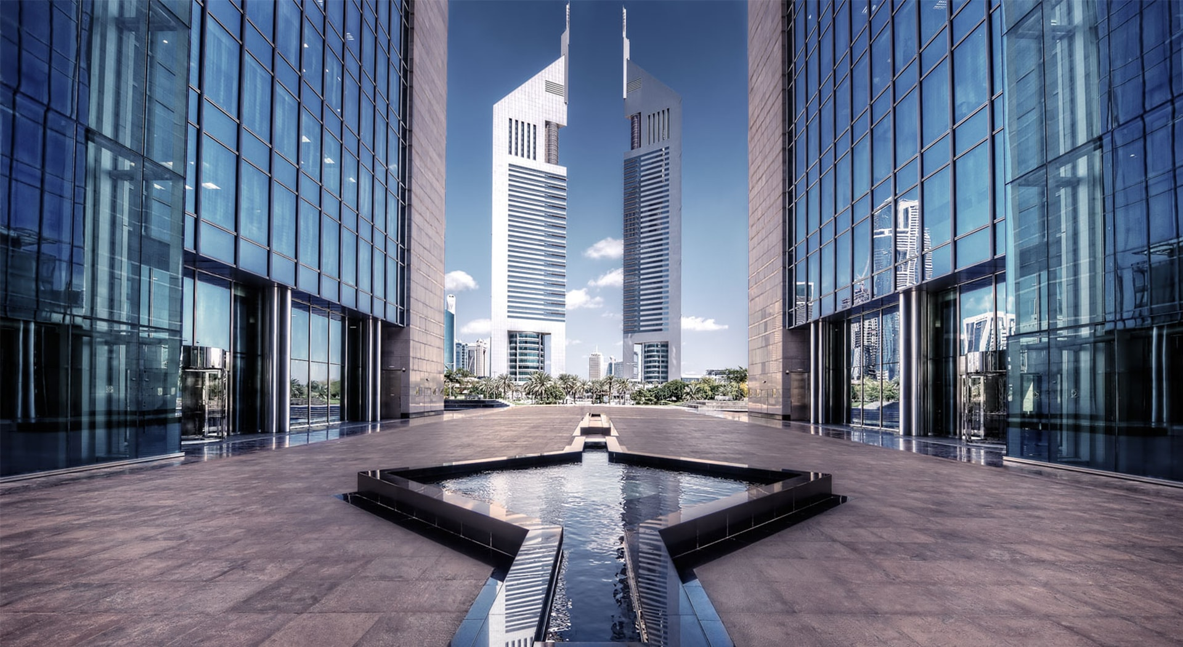
Company Introduction
Overview
Al Masah Capital, founded in 2010 is one of the leading independent financial firm in the GCC with a global reach, that provides an array of investment offerings and advisory solutions tailored to the needs of our broad client base.
Al Masah Capital is domiciled in the Cayman Islands with offices in Dubai United Arab Emirates.
We focus on providing in-depth expertise and fostering an environment that constantly seeks to enhance our society.
Amongst many accolades, we have been voted in the past as ‘Best MENA Asset Manager 2017’ with our Founder Shailesh Dash consistently ranked amongst the top 50 most influential people in the regional financial services industry.

Slide 3
Key Highlights
Al Masah Capital’s Highlights
US$ 1.75bn
40+
400+
TOTAL FUNDS RAISED
NUMBER OF EMPLOYEES
CLIENTS
US$ 1.8bn
2010
8
CORPORATE/ M&A MANDATES ADVISED
FOUNDED IN
PRIVATE EQUITY ADVSIORY CLIENTS

Slide 4
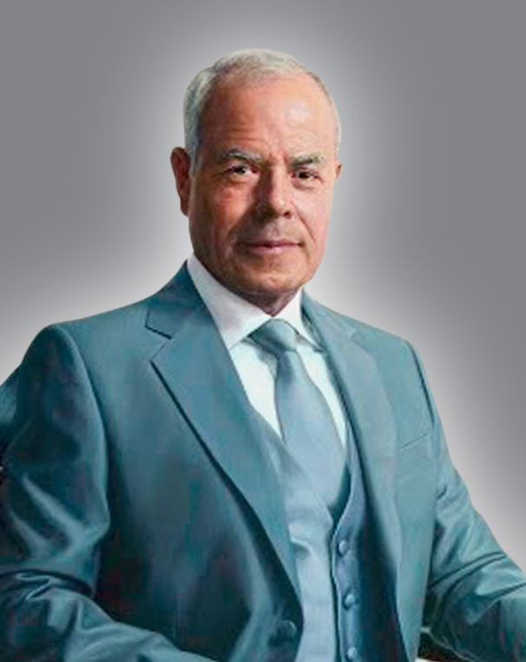
Letter from our Chairman
Statement of Continued Support to UNGC
Al Masah Capital Limited became a signatory to the United Nations Global Compact in 2017, and I am pleased to reaffirm our support to upholding its Ten Principles on Human Rights, Labor the Environment and Anti-Corruption.
In our annual Communication on Progress, we describe our actions to integrate the Global Compact and its principles into our business strategy, culture and daily operations.
As one of the leading advisory and asset management firms in the Emerging Markets, we recognize our potential to finding solutions, to innovate and collaborate to help tackle the world’s toughest challenges. Al Masah Capital seeks to spearhead these developments through its subsidiaries and partnerships.
Najjad Zeenni
Chairman
Al Masah Capital

Slide 5
Our Responsibility as an Employer
A Diverse Workforce and Provider of Equal Opportunities
Female to Male Employees
Today employs people from 18 different countries
>70% Of our employees are from Growth Markets

Slide 6
Our Responsibility as an Employer
Strong Corporate Governance
Our approach to corporate governance is to drive long term shareholder value whilst prudently managing risk and meet our broader responsibility to shareholders, investors and our communities that we operate in.
Independence
BOARD MEMBER COMMITTEE
Al Masah’s independent Board members are highly successful businessmen who built significant regional institutions.
The Independent Board members have no relationships with the company and can safely express opinions on the soundness of any related party transaction.
Risk Committee
Remuneration Committee
Audit Committee
Executive Management Committee
Strategy
Al Masah Capital’s board members ensure the Company’s strategies are frequently evaluated & implemented appropriately.
Our Board represents a pool of skilled individuals with expertise in the following respective fields:
Effectiveness
The Board of Directors represent the appropriate balance of skills, experience, independence and knowledge.
Al Masah Capital holds quarterly board meetings to evaluate and shape the company’s strategy effectively.
Corporate Finance
Fund management
Logistics
Food & Beverage
Healthcare
Real Estate
Investment Banking
Consulting
Legal
Debt Finance
Compliance
Energy
Integrity
Accountability
We have external and internal procedures that control all transactions; and rely on global professional service firms to mitigate any conflicts of interest.
Al Masah Capital maintains sound risk management and internal control systems through the framework of its board committees. The members ensure internal and external audits and risk reviews are conducted periodically.
The Group is regulated in various jurisdictions which include:
Transparency
We communicate periodically with our stakeholders and encourage their participation to ensure a mutual understanding of the company’s objectives.
Our Compliance team implements control procedures to ensure all regulatory requirements are met and best practices are followed.
Dubai Financial Services Authority
Emirates Securities and Commodities Authority

Slide 7
Funding Growth
Accelerating an Entrepreneurial Ecosystem
Al Masah Capital provides a variety of avenues for small to medium sized enterprises, start-ups, and entrepreneurs to raise capital from venture capital firms, angel investors, and private equity firms.
Bespoke Solutions
Supporting an Array of Clients
Corporate Advisory
Across Growth Markets
Feasibility Studies
Facilitating growth through financial solutions for:-
Private Placement
Client
Corporate Finance
Corporates
Entrepreneurs
SMEs/ MNEs
Start-ups
Research
Private Equity Advisory

Slide 8
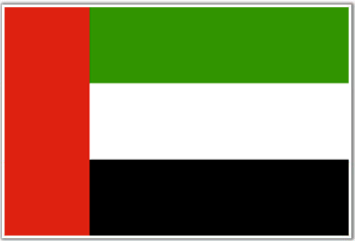
Sustainable Development Goals
Addressing the Sustainable Development Challenges
The role of the private sector has become an intrinsic part of sustainable development, and as an Emerging Markets specialist in the financial services industry we recognize our potential to help address the challenges.
UAE’s National Agenda
United Nations 17 Goals for
Sustainable Development
Priority Sectors
Society
Education
Healthcare
Police &
Security
Housing
Economy
Justice
Government
Services
Infrastructure

Slide 9
Digital Banking Client
Eradah Capital – Embracing Innovation through Technology
Location
UAE
Key Objective
To Launch a Digital Banking Platform
Al Masah Capital
Through its subsidiaries raised capital of over US$ 100m
Supporting UNGC 17 Goals
Initiatives | Goal Number
Supporting start-ups through various avenues of capital raising | 8,9
Creating a sustainable infrastructure to support economic development | 8,9,11
To create up to 50 new jobs | 1,2,3,8,
Building a strong institution with efficient mechanisms in place to reduce risk | 16
Incorporating good governance standards and processes | 16
Increase access of small-scale enterprises to financial services | 9
To adopt environmentally clean sound technologies | 7,11,9
One of the key verticals of the Digital Bank will be Trade Finance | 8,9
Eradah Capital’s Plans for Growth
Develop a sustainable, resilient infrastructure to cater to the MENA region
Invest in world class IT systems that is conjoined with the bank’s processes creating efficiency and reducing risks
Partner with leading fintech companies
To create up to 50 new jobs across the Digital Bank
Provide seamless online banking

Slide 10
Healthcare Client
Quality Healthcare Provider for the Low Income Population
Primarily caters to blue collar workers residing in labour accommodations; limited skilled workers & handymen comprising c.80% of the overall UAE workforce
Mandatory health insurance will make healthcare more accessible, especially for the low-income segments, resulting in higher propensity to seek medical services, hence improving volume uptake for clinics
Strong footprint in high density worker accommodation areas across Dubai and Northern Emirates
1233
Employees
23
Pharmacists
378
Nurses &
Lab Staff
222
Doctors
AED
300+
Location
UAE
Key Objective
Providing access to quality healthcare for low wage workers
Al Masah Capital
Advised the Owner (Doctor) of a chain of 47 medical assets who wanted to grow the business by improving accessibility, affordable healthcare and best practices by bringing in an institution.
AED 200
to
AED 300
Capturing the lower consultation fee bracket
(AED 35-50)
AED 100 to AED 200
Under AED 100

Slide 11
Healthcare Client
Quality Healthcare Provider for the Low Income Population
Supporting UNGC 17 Goals
Initiatives | Goal Number
Our client is providing affordable treatment for more than 300,000 patients annually | 3
By bringing in an Institution our client will be able to improve the quality of healthcare provided | 3
The clinics are strategically placed in labour accommodations to allow ease of access and mobility with further expansion plans | 3,8
Supporting an Entrepreneur (Doctor) with his plans to expand and continue to provide affordable healthcare in a cost-efficient manner | 3,8,9
Incorporating good governance standards and operational processes | 16
Mandatory health insurance will make healthcare more accessible, especially for the low-income segments, resulting in higher propensity to seek medical services, hence improving volume uptake for clinics | 1,3,10
Bringing in an institution allows our client to introduce new technology in healthcare services | 9
The consultation fees are in the lowest range enabling patients to frequently go for medical check ups | 3
An experienced team of 222 doctors supported by a capable team of medical and non-medical staff Over 50% of the doctors have more than 15 years of total experience, hence a strong infrastructure in place | 9

Slide 12
Mezzanine Financing Client
Tadeem Capital – Bridging the Funding Gap for SMEs
Target Geography
MENA & South East Asia
Key Objective
To provide an alternative source of financing for SMEs facing difficulty accessing capital
Al Masah Capital
Through its subsidiaries will be identifying strategic investors and educating prospective clients on the value proposition of private capital
Supporting UNGC 17 Goals
Initiatives | Goal Number
Bridging the funding gap for SMEs in the Emerging Markets | 8,9
Prioritizing SMEs in diverse sectors such as healthcare, education, logistics, and innovative sectors such as fintech | 8,9,3,4
Stimulating business growth in the region | 8
Assisting entrepreneurs in sustainable growth of their businesses | 9,11
Encouraging Private Capital investing in Emerging Markets where it is less prevalent, and where small-scale enterprises struggle to access bank funding | 8
Tadeem Capital’s Plans for Growth
With a projected size of US$ 920bn of the SME sector in the Gulf region by 2023, an increasing number of these companies are seeking capital due a shortage of efficient credit provided by banks in this market segment.
Tadeem plans to bridge this funding gap and offer solutions in the interest of the entrepreneurs and align the financial and business needs of these businesses.

Slide 13
Facilities Management Client
Al Maha Integrated Services – Supporting Small Businesses
Supporting UNGC 17 Goals
Initiatives | Goal Number
Encouraging the development of smart buildings and sustainable communities | 9,10
Planning to create new jobs in soft services such as cleaning, waste management, and security services | 8
Stimulating business growth in the region | 8
Assisting entrepreneurs in sustainable growth of their businesses | 9,11
Incorporated Corporate Governance, a board has been established, and will be establishing audit, risk, and renumeration committees | 16
70+
Employees
Location
UAE
Key Objective
Supporting businesses that focus on a niche segment of facilities management
Al Masah Capital
Through its subsidiaries is advising Al Maha on its growth plans to become a leader in facilities management & to operate its assets efficiently
Al Maha’s Plans for Growth
To become a mid size company with plans to expand in the Gulf, Oman and Saudi Arabia
Create good corporate governance structures
Plans to invest in smart buildings, security systems that generate useful data for businesses. With the emergence of more urban communities, the company recognizes the need for connected smart homes.

Slide 14
The Ten Principles of the UN Global Compact
The Ten Principles of the UN Global Compact |  | Implementation at Al Masah Capital
Human Rights
Principle 1 | Businesses should support and respect the protection of internationally proclaimed human rights; and | We follow international proclaimed human rights across our company and the clients we advise
Principle 2 | make sure that they are not complicit in human rights abuses. | Policies, procedures and guidelines are in place in our corporate governance framework
Labor
Principle 3 | Businesses should uphold the freedom of association and the effective recognition of the right to collective bargaining; | Employees have direct access to senior management to freely discuss any issues at work in order to reach agreements that are jointly acceptable Policies and procedures have been put in place by our HR department in the interest of both the employer and employees
Principle 4 | the elimination of all forms of forced and compulsory labor; | We follow international and UAE labor rights
Principle 5 | the effective abolition of child labor; and | Al Masah Capital does not engage with any party directly or indirectly that is involved in child labor Stringent risk and due diligence analysis are conducted when dealing with any party directly or indirectly
Principle 6 | the elimination of discrimination in respect of employment and occupation. | Employs a diverse workforce Currently employs a workforce of 18 different nationalities Has an equal ratio of female to male employees Barrier-free access Over 70% of our employees are from Growth Markets
Environment
Principle 7 | Businesses should support a precautionary approach to environmental challenges | We advise our clients to follow a socially responsible investment philosophy
Principle 8 | undertake initiatives to promote greater environmental responsibility; and | We advise our clients to follow a socially responsible investment philosophy Partnerships with Environmental agencies that collect our recyclable paper and plastic water bottles
Principle 9 | encourage the development and diffusion of environmentally friendly technologies. | Developments in IT and digital technology to encourage use of resources in a sustainable manner
Anti-Corruption
Principle 10 | Businesses should work against corruption in all its forms, including extortion and bribery | Regular internal training held for employees Compliance training held regularly on AML procedures, ethics & good conduct Oversight by Compliance & Risk and Corporate Governance committees

Slide 15
Disclaimer
The information contained in this presentation is provided solely for informational purposes and the users and readers are advised to cross check before acting upon the presentation. Neither this document nor any of the information contained herein may be reproduced or disclosed under any circumstances without the express written permission of Al Masah Capital Limited (“Company”). Although reasonable efforts have been made to ensure the accuracy of the information contained in this document, it may include certain inaccuracies or typographical errors which may be changed or updated later, at the discretion of the Company. In no event, shall the Company be liable for any direct, indirect, incidental or consequential damages arising out of or in any way connected with the use of this document, whether based on contract, tort, negligence, strict liability or otherwise.

Slide 16
Contact Us
AL MASAH CAPITAL LIMITED
Walkers Corporate Limited
Cayman Corporate Centre
27, Hospital Road George Town,
Grand Cayman KY1-9008,
Cayman Islands
Email: ir@almasahcapital.com
Web: www.almasahcapital.com
AL MASAH CAPITAL MANAGEMENT LIMITED
Emirates Financial Towers
North Tower, Level 6
Dubai International Financial Center
P.O. Box 506838
Dubai, UAE
Email: ir@almasahcapital.com
Web: www.almasahcapital.com

