Slide 2
Global Compact
Communication of Progress

Slide 3
Letter of commitment
Presentation of the company
Sustainable development goals
Human rights and labor law
Environment
Anti-corruption

Slide 4
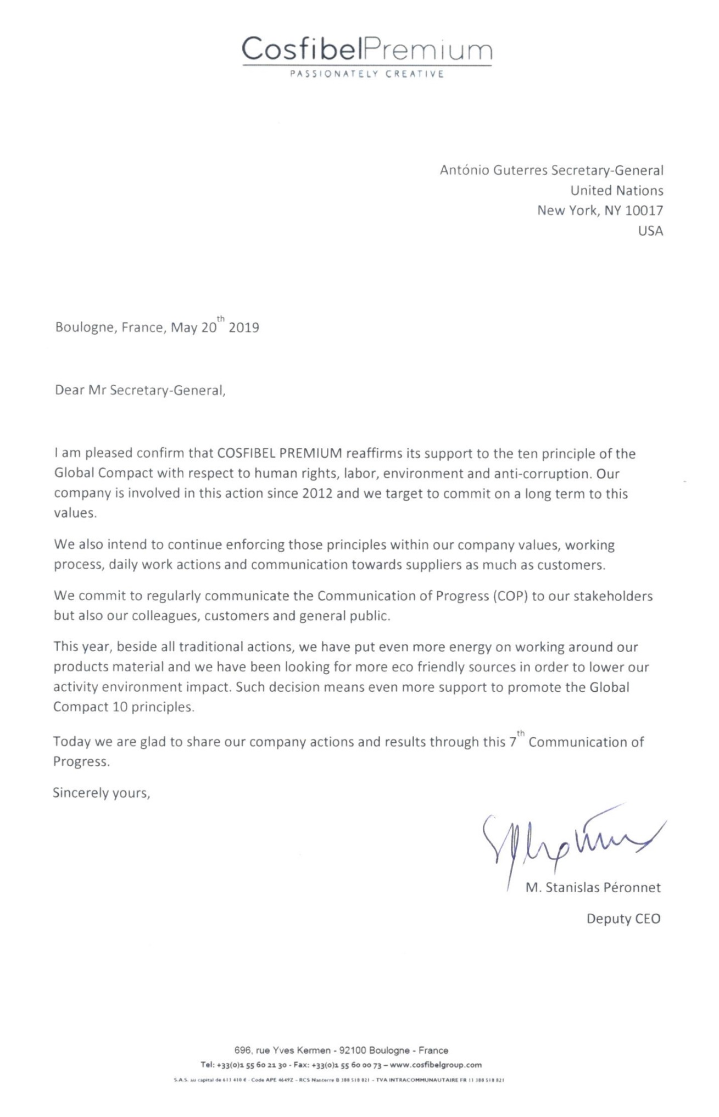
4

Slide 5
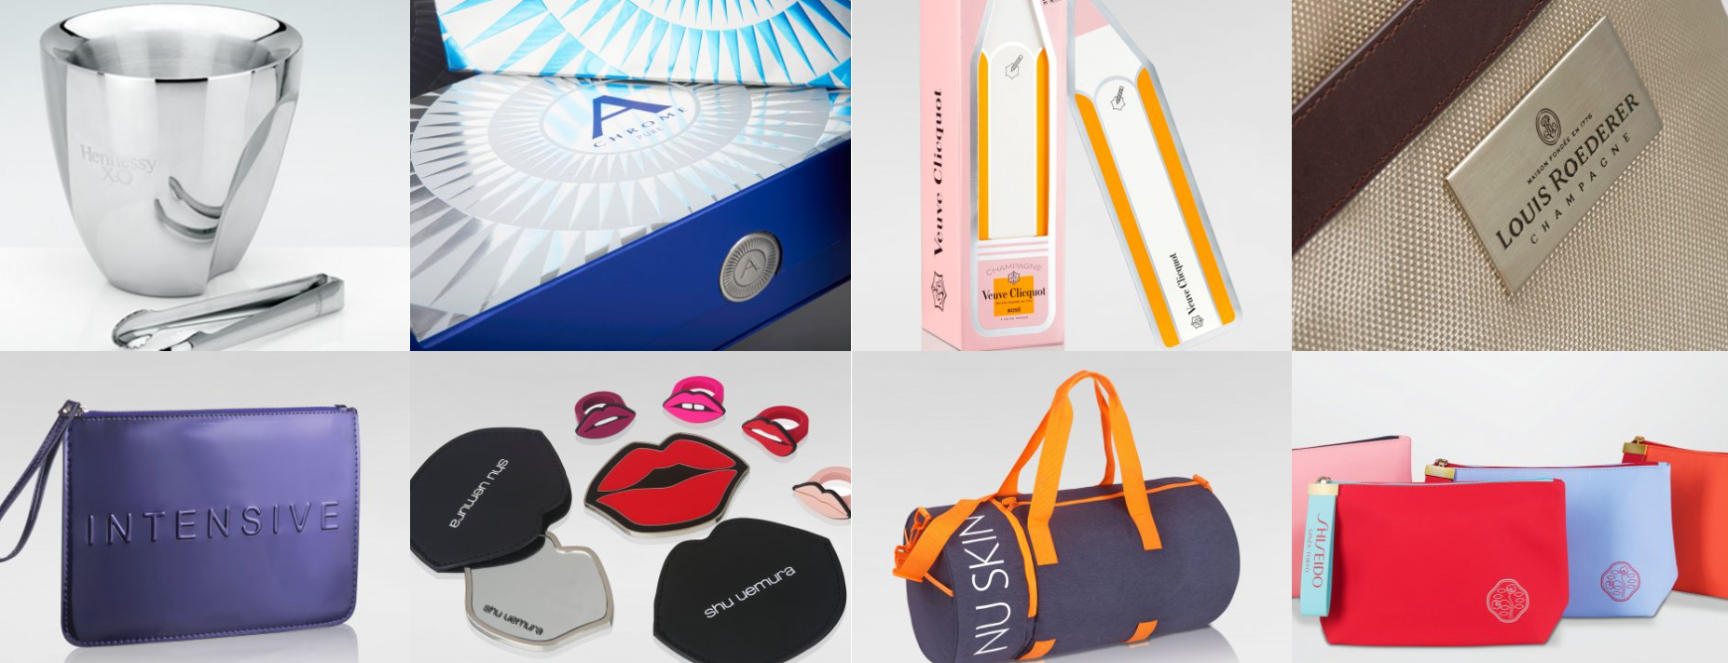
COSFIBEL PREMIUM, a member of the COSFIBEL GROUP, is a global provider of packaging and gifts solutions within the industries of beauty, wine & spirits and fine food. We offer International brands a global and innovative solution of personalized products and services in most of the developed or developing countries.
We study and develop packaging and merchandising solutions ranging from functional and aesthetic packaging to point-of-sale presentations, as well as promotional items such as bags, jewelry, towels and other gifts.
Cosfibel premium is a medium sized enterprise with a main office based in Boulogne-Billancourt in France. In order to strengthen our proximity with our suppliers and customers, half of our employees are based in Asia and our sales teams are located in 15 countries on 4 continents
Cosfibel, as part of the supply chain, is implementing its ethical and environmental requirements, as well as its customers ones, to the manufacturing suppliers, wherever located in the World.
5

Slide 6
Human Rights and labor principles
1 / The Group has a BOOK VALUES/ETHICAL CHART document which is regularly updated by our main shareholder and signed by our board of direction. Here is the last version`s sample :
«
»
«
»
Notes:
Code de conduite fournisseurs ?

Slide 7
Human Rights and labor principles
2/ COSFIBEL fully subscribes to the Declaration of the Human Rights and is in our daily mission to ensure that both Cosfibel Premium company as well as our suppliers do not infringe those pillars .
In order to reach both Cosfibel employees but also Cosfibel suppliers, the CSR team is dispatched as :
Mr Stanislas Peronnet, Cosfibel COO, based in Europe, 10% of his time on CRS.
One Ethical Sourcing Manager and based in Hong Kong,
One uditor, based in China mainland, 100% of his time allocated to CSR.
One social and environment projects coordinator, based in China mainland, 100% of her time allocated to CSR.
It shows a long term commitment to have invested in a stable team to reinforce both social and environment aspects and get closer to high risk regions which are mainly in Asia in the case of Cosfibel Premium activity.
The purchasers, wherever they are located in the World can only work with validated factories. Those factories were all approved by customers directly of Cosfibel CSR team. No non approved factory can become a Cosfibel supplier.
Beside, sales team is well trained on Cosfibel eco friendly products and lower acrbon foot print transportation options.
Our design team is also well aware of our more eco friendly products efforts.
So the all team is sensitive to CSR means and ready to work in a same ethical direction.
Notes:
Code de conduite fournisseurs ?

Slide 8
Human Rights and labor principles
3 / Cosfibel is a good example of women empowerment company. Also we are dedicated to trainee support and willing to help young students learn from our experience.
During the year 2018, Cosfibel Premium has employed 150 people.
In average over 2018, more than 68% were women in the Cosfibel Group
(including American continent, Europe, Dubai, Asia)
In average over 2018, more than 80% were women in our French head quarter
Our company has been training young students throughout the year with 23 Internship for the group in 2018
Cosfibel will pursue its effort to further train young students and give all legitimacy and power to women whenever there is a fair opportunity.
Notes:
Code de conduite fournisseurs ?

Slide 9
Human Rights and labor principles
4 / Above 85% of our purchase are done in China which is considered as a risky country for various infringement to human rights and issues on labor conditions.
Until 2016, Cosfibel has used both the resources of its own social auditor as well as third party company such as recognized ITS or SGS to audit as per various standards such as L`Oreal, SA8000 or SMETA 2 pillars mainly. From 2016, we decided to enforce SMETA 4 pillars audits and systematically suggest such audit to customers before considering going for other standards.
Not only this is adding up environmental assessment but also is giving those audited suppliers a common direction, is easier to compare their level within the same industry, follow their improvements and train them in systematic direction.
In 2018, Cosfibel has continued promoting this standard and will keep suggesting this standard in priority to other solutions in 2019.
Some figures :
With 1 BV certified internal auditor, Cosfibel has carried at least 102 actions in our main Chinese suppliers in 20178 (pre-audit, audits and social trainings)
Between 2007 and end of 2018, Cosfibel has carried on over 1000 social actions
Between 2007 and end of 2018, Cosfibel has conducted a total of 707 audits and 216 audits have been conducted by 3rd party or customer itself.
We also have an increase of customer audit conducted by their own audit team. This improve the communication of customer CSR teams and purchase teams so that a more efficient and ethical decision of purchase can be done.
Notes:
Code de conduite fournisseurs ?

Slide 10
Human Rights and labor principles
5/ In 2017, Cosfibel Premium has decided to widen the scope of its social program CARES® (“Cosfibel Actions for Responsible and Ethical Sourcing”) related to social and environment aspects.
CARES® is now including all our social and environmental actions and its name and/or logo is included in all our communication tools.
Thanks to this communication tool and because CARES® was already well known in Cosfibel Group as well as among Cosfibel customers and suppliers, Cosfibel emphases the importance of its social actions and involves all departments.
In 2017, in its Social and Responsible Policy, Mr Stanislas Peronnet, COO of Cosfibel Group insists that :
«
»

Slide 11
Environmental principles
1 / COSFIBEL has been involved for several years in an active approach to sustainable development, one of the three pillars of which is respect for the environment. In 2018, the creation of a Sustainable Development Department intensified this approach.
In 2017, on our BOOK VALUES/ETHICAL CHART we now declare :
In 2017, Cosfibel states in its Quality manual :
“ENVIRONMENTAL SOLUTIONS: We are turned towards sustainable development always more efficient for an optimized environment protection and can propose to our customer environmental friendly packing and recycled materials. FSC certification: Cosfibel is FSC certified (French and Hong Kong offices) and is able to sell and develop FSC certified items. Environmental ”

Slide 12
Environmental principles
2/ Our “General Terms of Purchase” also include environmental commitments, and in particular recommendations on the materials used:
The deliberate addition of chemicals that may be hazardous to health or to the environment is strictly forbidden.
We prefer to use recycled materials, provided that these materials are of the requisite quality and that sufficient quantities are available. We also wish to be notified in the event that recycled materials may potentially be used, so that we can offer this option to our customers.
The minimum possible volume of packaging must be used.
All paper and cardboard must be ECF (Elementary Chloride Free).
Compliance with the chemicals regulations and the protection of the natural resources of each country and region is our priority. We have a strict program for the European Reach regulations and the RBUE regulations for example. We are also cautious to all developments outside Europe (USA and Japan Textile Standards, California Proposition 65, etc.) and we must respect higher standards either on our own initiative or from our customers. We carry out regular laboratory tests to ensure the absence of prohibited substances and carry out strict follow-up of traceability and original research of materials. We involve our suppliers and we also ask them to confirm in writing the compliance of the goods to our local countries regulations or customer own requirements.

Slide 13
Environmental principles
3/ In 2017, Cosfibel organized a 44 questions environment questionnaire following the basics of ISO14001, and in 2018 we kept working on this program.
The purpose is to check factory situation in details and have a proper action of training on precise points whenever a major or critical point is found.
Cosfibel is so far organizing those actions together with his internal auditor.
Procedure :
1-Ask factories to answer to the questionnaire by themselves
2-Cosfibel auditor go to factories and check each points and supporting documents together with factories.
3-Discussion and training start whenever there are discrepancies with the original self questionnaire or with the audit.
In 2018, Cosfibel has persue the program and kept audits and tracking of the factories situation
Some figures :
In 2018 Cosfibel has organized 14 environment self questionnaires,
Until Dec 2018, Cosfibel has organize 13 on site environment audits.
As per December 2018, average result is just above 68%. Our target by end of 2019 is to reach a result higher result
We also aim at adding more factories to this supplier base so we cover the main risky suppliers

Slide 14
Environmental principles
4 / In 2009, we carried out a carbon footprint study of our Group.
This study enabled us to highlight the most greenhouse gas emitting process in our business:
48% are related to the transport of goods
41% related to the materials used to design our products
We keep developing our action plan through the constant search for more environmentally friendly solutions to lower above impacts.
=>Impact on our material choice and products design
=>Impact on our logistics and suppliers location versus our customers warehouse location
This effort to understand where is our impact is just a fundamental to our company daily work and efforts.
Reduction of volumes transported to customer markets through optimization of packaging. Aim is to lower Green House Gaz

Slide 15
Environmental principles
5 / More communication to spread the environment effort.
2018 is also the year of a better and more efficient communication.
Thanks to our intranet, we communicate on instant manner to all our findings. Our Worldwide network is active and connected to our CSR books and get all relevant eco friendly solution in a few clicks. We also organized weekly, monthly and bi monthly meetings over 2 to 3 continents in order to have immediate spread of new and more eco friendly material or design solutions.

Slide 16
Environmental principles
Our goals in 2019 in term of logistics :
To prioritize the sea shipment
To keep effort to convince our customers of the benefits shipping by train shipments instead of air shipments (when need to reduce transportation timing)
To suggest new routes of transportation such as small rivers and secondary ports in France so we save the last bit of truck transportation which has a high impact on GHG.
To use tools to optimize the containers loading
6/ Proximity of purchase and production. For European markets, we increased the search for sourcing alternative to Asia and closer to our delivery locations which is materialized by the development of partnership with suppliers in Brazil, Tunisia and Southern Europe.
Therefore we have some exclusivity agreement on gifts as well as packaging in close-by factories : Portugal, Tunisia, Spain, etc.
Aim is to lower Green House Gaz of our goods transportation.
Notes:
3/ Dans notre activité, c’est l’empreinte Transport qui est importante.
Pour tenter de la réduire au maximum, nous privilégions le transport maritime (par rapport au transport aérien) qui est le moyen de transport le moins impactant pour l’environnement. Aujourd’hui environ 95% de nos transports principaux de marchandises sont effectués en maritime. Notre objectif est de tendre vers 100%.

Slide 17
Principles of the fight against corruption
In Cosfibel, the anti corruption guidelines and principles are express on a direct and clear manner towards both Cosfibel team and its suppliers through :
-Our "General Terms of Purchase“
-Anti bribery Policy
Our control policy is defined in a very strict and constant awareness of our teams to prevent corruption such as:
The selection of suppliers is done on the basis of competitiveness and quality performance criteria calibrated by quantitative and qualitative indicators. (Same guideline applies to all suppliers) In order also to limit the corruption risk, we have group decisions on the suppliers choice and attribution of big orders.
Cosfibel employees including sales and purchasing operations are aware of such risk among customers and suppliers and ensure the transparency of the markets on which they are working.
Regular trainings of the team but also regular reminder to suppliers about none bribery is conducted from top management to middle management and this from every offices of Cosfibel Group.
17

Slide 18
Active support for the UN's sustainable development goals
Cosfibel contributes to the broader objectives and issues of the UN:
We contribute, directly or indirectly, through our business and competence to the following broader United Nations development goals.
With its own CARES program (Cosfibel Actions for Responsible and Ethical Sourcing), Cosfibel main targets for 2019 are :
Increase the number of FTE (in 2019) (L`Oreal program)
Develop new supplier for Solso program
Increase the use of more eco friendly material and construction for our final products
Increase our logistics good practices to lower environmental impact
Improve the various Cosfibel policies wording and spread among all teams
18
Notes:
Critère 15 : La COP décrit les contributions du coeur de métier aux objectifs et problématiques plus larges de l’ONU
Critère 16 : La COP décrit des investissements stratégiques sociaux et de philanthropie
Critère 17 : La COP décrit une prise de position et un engagement en matière de politique publique
Critère 18 : La COP décrit des partenariats et une action collective

